Slide 1
Marijuana & your health
Prepared by the Dakota High School Student Assistance Program

Slide 2
What is marijuana?

Slide 3
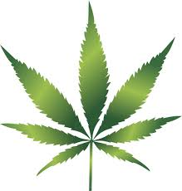
Marijuana, one of the most often-used drugs in the U.S., is a product of the hemp plant, Cannabis sativa.
The main active chemical in marijuana is THC. Of the roughly 400 chemicals found in the cannabis plant, THC affects the brain the most. It is a mind-altering chemical that gives marijuana users a high.
Marijuana itself is a green or gray mixture of dried, shredded flowers and leaves of the hemp plant.
Marijuana can be smoked, vaped, or consumed as an “edible”

Slide 4
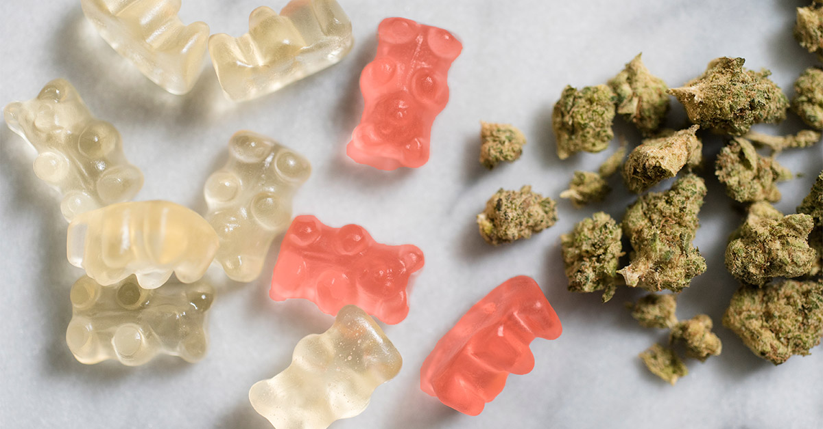
Marijuana edibles
Marijuana edibles, such as cookies, brownies, or candy items like gummy bears, can have MANY times the usual dose of THC.
When marijuana edibles are used, the effects are delayed. The most intense effects may not be felt for 3-4 hours after the edible is eaten.
Someone experimenting with edibles may then eat more in an attempt to "get high."
THIS LEADS TO DANGEROUS OVERDOSING.

Slide 5
Marijuana & the four circles of self-care
Notes:
The use of marijuana negatively impacts your health in more ways than you might imagine. You may have heard of the four circles of self-care.

Slide 6
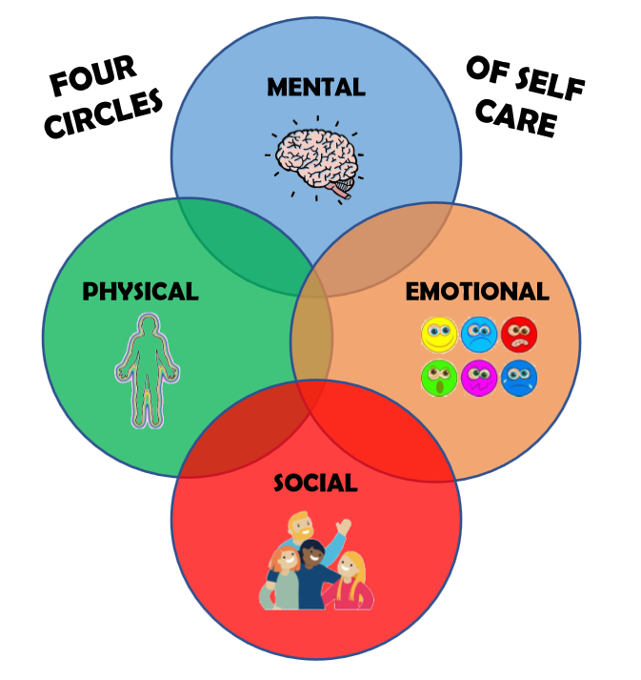
Notes:
Self-care includes all the things you do to take care of your well-being in four key dimensions –mental, physical, and emotional health, as well as your social connections. In contrast, negative practices and behaviors, such as abusing a substance, can harm each of those aspects of your wellbeing. Let’s look at how marijuana impacts the four circles of self-care.

Slide 7
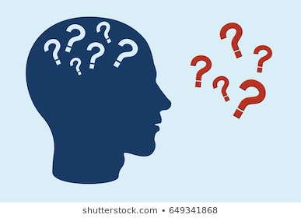
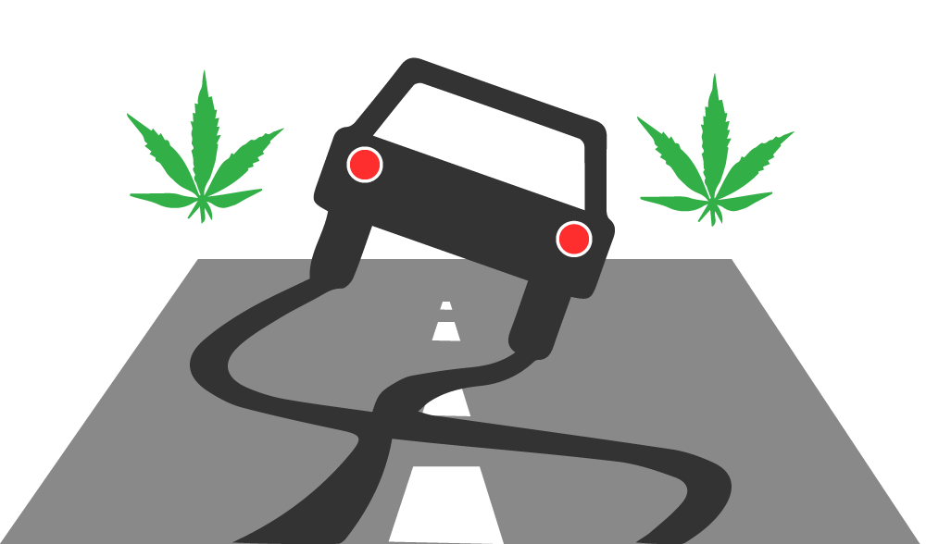
mental
Adolescent brains are still developing—at least until age 25.
Using marijuana “teaches” the brain that it needs that chemical (THC) to function.
Young people are MUCH more easily addicted than adults.
SHORT-TERM EFFECTS:
Problems with memory & learning
Distorted perception (sights, sounds, time, touch)
Hallucinations, paranoia, confusion
Trouble with thinking & problem solving
Addiction to THC primes the adolescent brain for addiction to other drugs--such as alcohol, cocaine, or opiates.
THINK: IMPAIRED LEARNING IN SCHOOL; IMPAIRED DRIVING

Slide 8
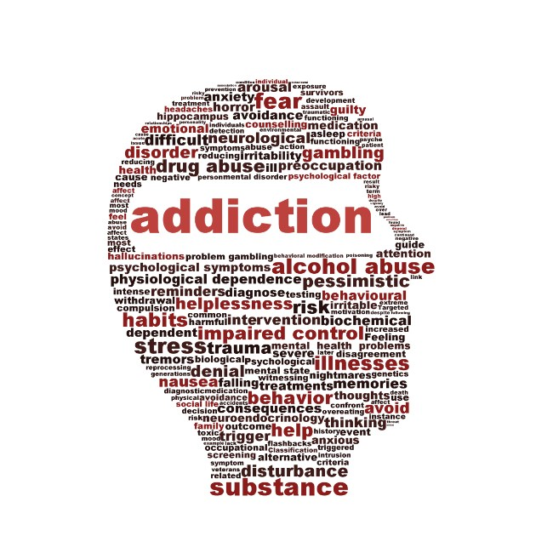
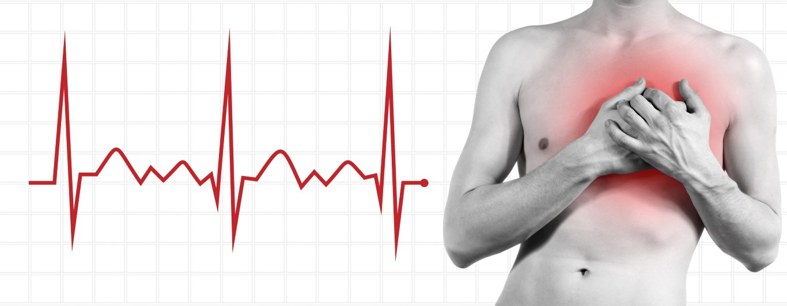
physical
Dizziness, nausea
Loss of motor coordination
Drowsiness
Eating and sleeping problems, increased appetite
Increased risk of chronic cough, bronchitis
Increased risk of schizophrenia in vulnerable individuals
Respiratory ailments
ADDICTION
INCREASED HEART RATE, LOWERED BLOOD PRESSURE

Slide 9
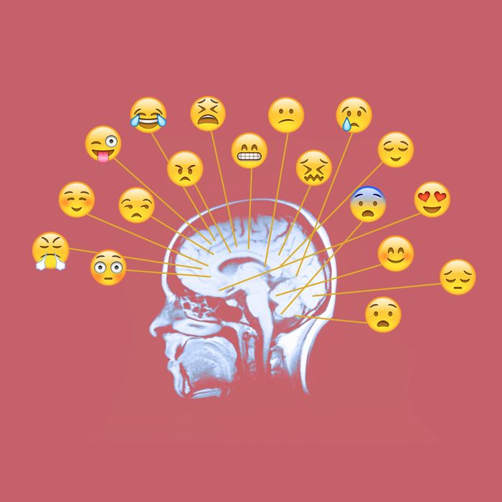
Emotional
Marijuana may increase the risk of anxiety, depression, and attitude/personality changes
Using marijuana as a coping method for anxiety, depression or stress stunts the emotional coping process
Using marijuana causes difficulty holding back and controlling emotions
Notes:
When teens use marijuana as a coping method for anxiety, depression or stress, it may provide instant relief and gratification. This process of using marijuana to deal with negative feelings stunts the emotional coping process. Teens are then more likely to continue this behavior. The teen’s stress tolerance is lowered, because they have not experienced the natural passing of the feeling, and they have not found and used a healthy behavior to aid in coping with the pressure and stress he feels—such as playing sports, hanging out with a friend, listening to or playing music, talking to someone, reading, etc. This is why regular pot users who start as teens and stop when they are adults may have a difficult time working through emotions. They are essentially learning healthy behaviors and coping skills that they should have acquired years ago.

Slide 10
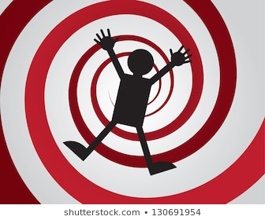
social
Addiction & changes in behavior and personality caused by marijuana negatively impact relationships with friends & family members
Impaired judgement
A preference for high-excitement and low-effort activities
More risky, impulsive behaviors, including experimenting with drugs and alcohol
Changes in priorities
Less responsible & reliable
Less open & honest
Addiction can lead to a downward spiral that destroys a person’s school, work, family or social life

Slide 11
VIDEO: EFFECTS OF CANNABIS ON THE TEENAGE BRAIN
Notes:
Now let’s watch a video recapping the toll marijuana will take on your health and your brain.

Slide 12
Be your best self!
Make positive choices every day
Notes:
To be your BEST SELF, avoid marijuana, vaping, alcohol and other drugs. Nourish yourself mentally, physically, emotionally, socially and spiritually. Make good choices daily and adopt positive habits.

Slide 13
Get help if you need it!
DAKOTA STUDENT ASSISTANCE CENTER
Ninth Grade Center Room 357:
Mrs. Black, lblack2@cvs.k12.mi.us or (586) 723-3331
Main Building Room 249:
Mrs. Lange, slange@cvs.k12.mi.us or (586) 723-2872

Slide 14
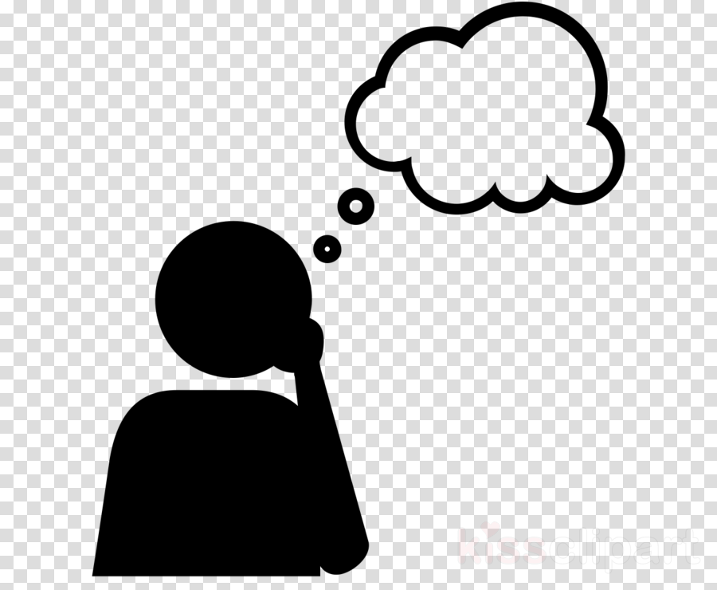
assignment
Visit the SMART APPROACHES TO MARIJUANA website: https://learnaboutsam.org/
Choose one article that interests you. Read the full article, write a brief summary and explain why you agree or disagree with the article’s argument.

