Slide 1
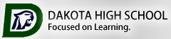

2020-2021 Course Selection

Slide 2
Course Requests
A Course Request JotForm link will be sent to each student via schoology and school email.
    The completed course request JotForm & AP contract are to be returned, with a parent signature, on or before your assigned scheduling day.
    In March, reminder message will be sent to all students regarding their assigned day to input course selections in the Student Portal.

Slide 3
Courses
Courses and descriptions are listed in the Course Offerings Book, located under the counseling tab on Dakota’s website. https://www.chippewavalleyschools.org/schools/high-schools/dhs/guidance/course-scheduling/.
As you read through the options, be sure to choose wisely; we may not be able to make any schedule changes in the Fall.
Classes must meet graduation requirements.
Take time to discuss with your parents, counselor and teachers what courses are best suited for you and your future goals.
Notes:
Important: emphasize that schedule changes will not be granted in the fall when school begins.

Slide 4
Courses
You will be selecting 12 courses that equal 6 credits.
You will also be selecting 4 alternates. These selections should equal 2 additional full credits.
Choose thoughtfully as one or more of your alternates may be used to complete your schedule if there is a conflict.
The schedule for next year is built based on the requests you make now so please choose wisely!
Requests for schedule changes may not be honored due to limited availability based on your current selections.
Notes:
Please emphasize the bolded text.

Slide 5
XELLO Course Planner
Students should use XELLO course planner as a guide for their scheduling JotForm.
  When completing your JotForm for submission, please be sure that you also enter them into your XELLO course planner so you can reference it when putting your choices into Powerschool in March.
  Once your JotForm is submitted, you will not be able to view it again.
  Directions for XELLO can be found on the Counseling website under Course Scheduling and College/Career Information.
  https://www.chippewavalleyschools.org/downloads/dhs/xello_information.pdf.
Notes:
Please emphasize the bolded text.

Slide 6
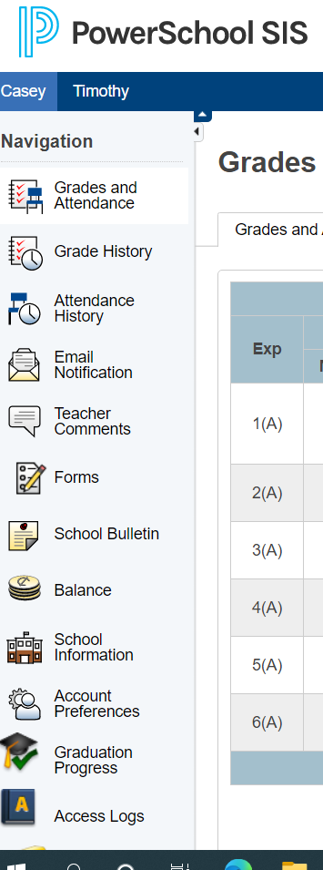
Requirements
Use
Use your graduation audit form to check off graduation requirements you have already completed.
Log
You can log into your student portal to view your course history in order to complete this task.
See
If you believe you may be missing credits for graduation, see your counselor to develop a plan to make up credits.
Notes:
If time allows at the end of the presentation, please allow students to complete the check off on the schedule request form.

Slide 7
Career & Technical Education
CTE classes are a great way to explore possible career options and confirm interests
CTE Courses are for every student. Programs include:
  Auto Technology (at CVHS)
  Business-4 Pathways
    Business Management
    Accounting
    Cybersecurity (at CVHS)
    Information Technology (at CVHS)
  Construction Trades
  Design Technology/Engineering
  Consumer Science
  Graphic Design (at CVHS)
  Culinary Arts
  Marketing
  Medical
  Mechatronics
  Careers in Education
  Woodworking & Cabinet Making

Slide 8
Forms
Your JotForm must be completed accurately.
Your JotForm must total six (6) credits, plus two credits of alternates. We need to use alternates on occasion, so make sure you put classes you would like to take, if necessary.
All required signatures, needed applications, and/or essays must be obtained and completed in order to schedule. (For example: Yearbook, Careers in Education, and Student Leadership applications)

Slide 9
Jotform
Do not submit your JotForm until you have had all of your questions answered by your counselor.
You will only be able to submit your form once, so it is important to make sure it is accurate. All JotForms are due on March 1, 2021.

Slide 10
Incoming Juniors
Juniors must take the following courses:
  - English – 1 credit (English 11, Med English 11 for those enrolled in the medical academy) or AP Language and Composition)
  - Math – 1 credit (discuss options with Math teacher and Counselor)
  - Science – 1 credit
    Earth 1 - .5 credit AND Earth 2 or Chemistry II, or Physics II
    Or AP Environmental Science I/II (discuss options with Science teacher and counselor)
  - Economics - .5 credit – (may be taken in 11th or 12th grade)
    Or AP Macro/Microeconomics – 1 credit
  - Government - .5 credit – (may be taken 11th or 12th grade)
    Or AP Government and Politics I/II – 1 credit
  *Remaining courses/credits should be chosen to work towards graduation requirements and college/career goals
  **If a student has not begun the World Language requirement, they should begin it during the junior year

Slide 11
Incoming Juniors
  If you have NOT completed Physical Education 1 and 2, you MUST either:
    make plans to fit it into your schedule during your junior or senior year.
    -or-
    complete a PE Waiver Form, to waive ½ credit of PE if eligible. When completed, submit the form to the Counseling secretary. You must do this by the end of this academic year.
***Without a waiver on file, counselors must schedule you into a second PE class. They will not take any “chances” with your pending graduation! Do not wait as last-minute changes may not be available.
Notes:
Please be sure to iterate the bolded text.

Slide 12
Incoming Seniors
You may need four core classes each semester of your Senior year to be considered for admission to some universities (such as U of M and MSU).
Since college/university admission criteria is different from the State and district graduation requirements, students should contact the university admissions office(s) to which they may be applying to make sure your selections meet their admissions requirements. It is suggested that you get this information in writing.
Notes:
Teachers please emphasize this slide to incoming seniors.

Slide 13
Incoming Seniors
Seniors must take the following courses:
  English – 1 credit
    English 12, Med English 12 (only for those accepted into year 2 of the medical academy), AP Language and Composition, or AP Literature
  Math – 1 credit
    All students are required to take math or a math related class in the senior year. Students who have already earned four (4) credits in math, are still required to have a math or math-related class in the senior schedule.
    See page 15 of the course book for a listing of approved math-related courses.
  Economics - .5 credit
    Or AP Macro/Microeconomics – 1 credit
    If not taken in the junior year
  Government - .5 credit
    Or AP Government and Politics I/II – 1 credit
    If not taken in the junior year
  Remaining credits (courses) should be chosen to work towards graduation requirements and college and career goals

Slide 14
Incoming Seniors
Internship
  Only for senior students who are enrolled in a related CTE course/program of study.
  See Course Offerings Book for course numbers, pre-requisites for Internship, and related classes.
  Seniors may take one or two hours of internship and will be dismissed from school after 4th or 5th hour (you must have your own transportation).
  Senior students interested in Internship who have additional questions should see Mr. Morris, the internship coordinator in office 220 or their counselor.

Slide 15

Incoming Seniors
Students will not be allowed to participate in graduation ceremonies if all graduation requirements are not met.
  Students must earn 22 credits and earn credit in all required course work
    Refer to page 4 of the course book

Slide 16
NCAA:
You Must Apply BEFORE Senior Year Begins
If you have interest in playing a sport in college:
Talk to your counselor and your coach as early as 10th grade, but no later than the end of junior year.
The list of NCAA-approved courses and Division I and II eligibility worksheets are under the Counseling tab on Dakota’s website.
Keep track of NCAA requirements and verify that your course selections meet those requirements.
Note:
Transfer Students – It is your responsibility to make sure your courses taken out of district are NCAA eligible.
Most online courses are not NCAA eligible.
You will need to have most of your NCAA requirements met by the start of senior year

Slide 17
Additional Information
After School Credit Recovery and Summer School
See your counselor for information regarding after school credit recovery should you need to recover a credit.
Summer school information will be available in early April. Summer school offerings are generally course’s that meet basic academic requirements.
Testing Out
Refer to page 7 of the course offerings book.
Forms are due to your counselor by Friday, May 1, 2021.

Slide 18
Additional Information
Dual Enrollment
    For qualified students wishing to take classes at a local college while in high school. Specific requirements must be met to be eligible for this opportunity.
    Students should visit the DHS website, Counseling tab Dual Enrollment link for specifics and requirements.
    Additional information is on page 6 of the course book on our website.
    Refer to the website for updated information about the deadline for documentation. We will not be able to accept forms after the deadline (usually May 1st).

Slide 19
Additional Information
  Dual Enrollment Continued…
  How
  Students will use the following course numbers on their schedule request form.
    Fall HS9670
    Spring HS9680
    These numbers indicate that you will be leaving school at the end of 5th and/or 6th hour to attend college classes.
  Students will need to check the counseling website under dual enrollment and meet with their counselor.
  Registration for fall classes at the college will be in June, winter semester is in October.
  It is important that you adhere to the deadlines for dual enrollment.

Slide 20
Deadlines
The student portal will be open for students to enter course requests from March 8, 2021 until March 15, 2021.
All forms and applications (if applicable) must be completed, with signatures, or you may not be able to register during your scheduled time.

Slide 21


