Slide 1



1
Notes:
The choices our athletes make about how much sleep they get, what they eat and if they use caffeine, alcohol and other drugs has an impact on athletic performance and their performance in school. It can mean the difference between winning and losing, which is the message we are attempting to send to our student athletes. A large part of performance is based on how athletes treat their bodies.

Slide 2


Adapted, with permission, from the Life of an Athlete New Hampshire/John Underwood
Life of an Athlete Chippewa Valley Schools is a Partnership between Chippewa Valleys’ Athletic Departments and the Coalition for Youth & Families
Life of an Athlete Chippewa Valley Schools is intended to promote athletic excellence and to foster leaders among our athletes.
2
Notes:
The Chippewa Valley Coalition for Youth and Families joins School, Family, and Community in preventing and reducing youth substance use and preventing youth suicide.
Funds for the development of Life of An Athlete Chippewa Valley Schools were provided by Drug Free Communities grant funds awarded to the Coalition.

Slide 3
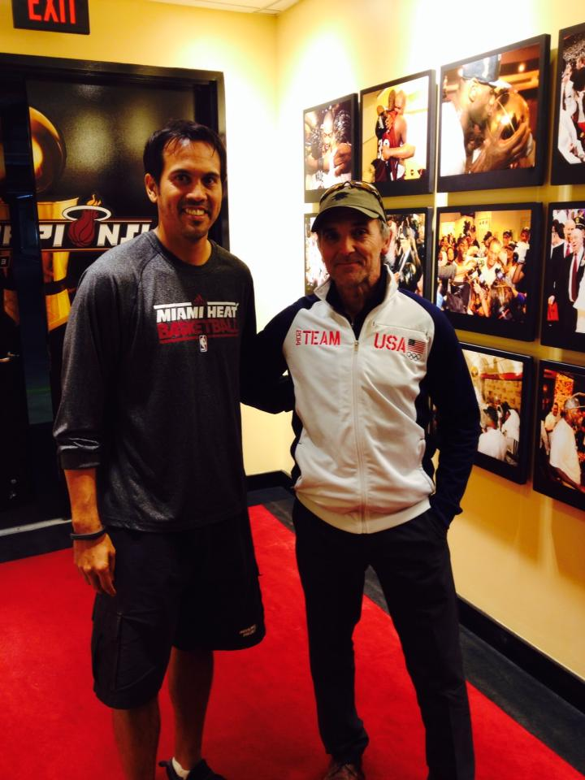

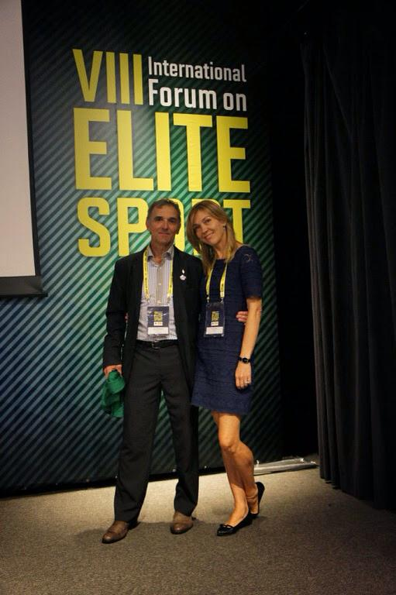

John Underwood
Life of an Athlete
FPO
3
Notes:
John Underwood is an Olympic trainer and coach. He has worked with high school and professional athletes, including the National Federation of High School Athletics, NCAA, NHL, NFL and the NBA. He has worked for three decades with the USOC, Sport Canada and the International Olympic Committee. John Underwood is Human Performance Consultant for U.S. Navy SEALS. John’s innovative program “Life of an Athlete”, has gained international prominence and has been implemented in hundreds of schools throughout the country and abroad. He studied Human Performance at the Sport Institute of Finland/ Vierumaki/ and Lake Placid. He holds three International Olympic Solidarity diplomas for coaching and has been a crusader for drug-free sport at all levels. John is an internationally recognized human performance expert, specializing in recovery, peaking training and lifestyle impact on mental and physical performance.

Slide 4
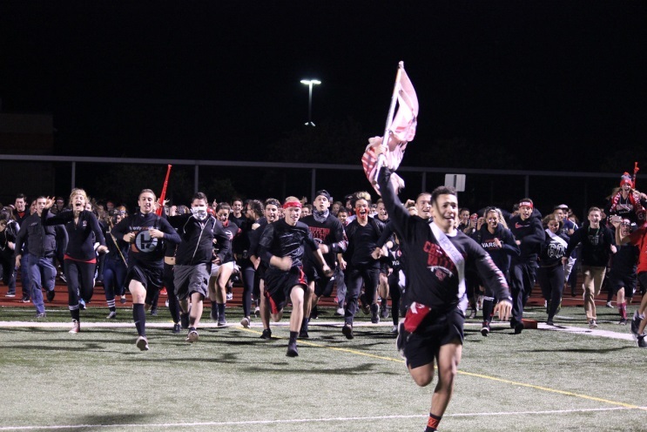
Lifestyle Choices
Why are lifestyle choices important?
Without making healthy decisions athletic performance can suffer. It can be the difference between:
WINNING & LOSING
CHAMPIONS & COMPETITORS
4
Notes:
The choices we make about how much sleep we get, how we eat, and if we use caffeine, alcohol and other drugs has a direct impact on athletic performance. It can mean the difference between winning and losing, which is the message we are trying to get out to our student athletes. A large part of our performance is based on how we treat our bodies prior to and post contests and events.

Slide 5
Impact on Your Athletic Performance
Sleep
“3 Pillars” of Good Health- Diet, Exercise, Sleep
8-10 Hours of sleep per night
  6-7 REM Cycles per night
  Body replace cells all the time, but not brain cells
  In order to repair brains cells you must shut system down(spinal fluid flush out toxins, cells distance is greater during sleep)
If you don’t receive this amount of sleep:
  Split second decision making decreases
  Reduce Blood Flow
5
Notes:
Good Health is Comprised of 3 things:
Diet, Exercise, and Sleep. Rest and recuperation allows the body to reenergize and rejuvenate for next the next day. Its vital to get a good night sleep to perform at an athlete’s best.
The REM cycle is the dream state, think about it as re-booting your brain. To complete this properly you want 6-7 REM cycles, which happen over 8-10 hours
Red/orange light tells the pineal gland to start shutting down to go to sleep. (Think gathering around the warm glow of a fire at night.)
Blue light (that from a TV, Phone, Computer) tells the pineal gland to start revving up. (Think bright blue skies in the morning.)
In addition, the use of alcohol, marijuana, and other drugs, and prescription drug abuse has very negative consequences for athletic performance.

Slide 6
Impact on Your Athletic Performance
Likelihood of Injury Based on Hours of Sleep per Night
Y=12.6x+87.6
R^2=0.727
Likelihood of Injury Over 21 Months
Average Sleep per Night (Hrs.)
6
Notes:
Here you can see the more sleep an athlete gets the less likely he/she is to have an injury. Making an extra effort to get to bed at a reasonable time can make all the difference in performance. Student athletes often have rigorous schedules, so staying on top of school work and athletics helps provide a better sleep schedule.

Slide 7
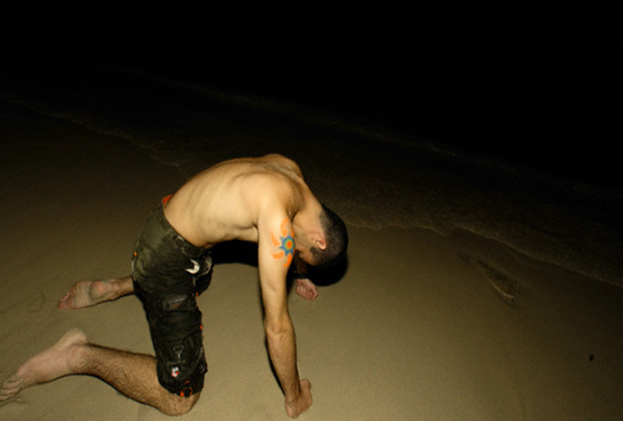
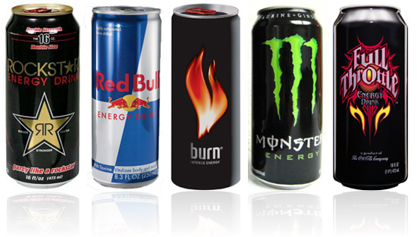
Overstimulation
Energy Drinks
Our Central Nervous System (CNS) can only be at maximal intensity level for only 2-3 hours
Overstimulation causes the CNS to break down and eventually results in chronic fatigue
Limit ability to maintain a high level of mental & physical performance rather than increase it.
Red Bull, Monster, Rockstar,
Mountain Dew Amp, NOS, Tilt
FPO
7
Notes:
Even if an athlete is making the right lifestyle decisions, he/she can only perform at his/her physical peak for 2-3 hours. After that muscles become fatigued and need rest.
Athletes often use energy drinks.
Energy drinks can cause overstimulation and over time you have more difficulty getting to where you want and need to be.
The sugar and caffeine rush only lasts 15-20 minutes and after that the mind and body crashes.

Slide 8
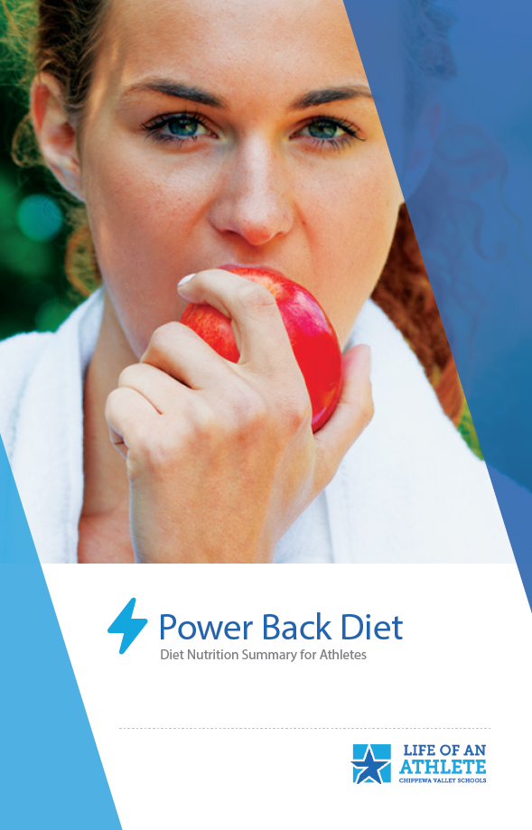

Impact on Your Athletic Performance
How to fuel your body:
Keep your blood sugar UP
Your body runs on GLUCOSE
  Whole Grain Pasta
  Fruits
  Vegetables
Your body DOES NOT run on SWEETS
  Cake
  Candy
  Cookies
FPO
8
Notes:
The Life of an Athlete Powerback diet provides the proper nutrition for an athlete. An electronic version can be found on our Chippewa Valley Life of an Athletic website.
The best way to keep the blood sugar up is to eat whole grains, fruits and vegetables. Cookies and cakes are digested as sugar and leave an athlete feeling depleted.
Athletes need to plan ahead with snacks so they feel full longer.

Slide 9
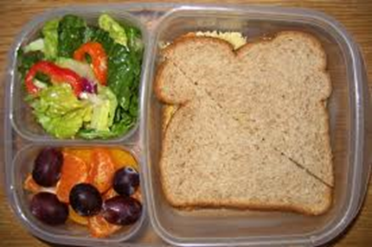
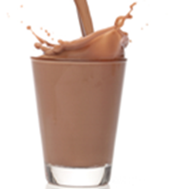
Impact on Your Athletic Performance
Phase 1: Before Competition or Training:
EAT:
-Carbohydrate-rich meal or snack 2-4 hours before exercise
  ½ Turkey Sandwich, Small Salad
  String Cheese, Crackers and an Apple
  Cereal, Banana and Peanut Butter
DRINK:
-Include small amount of fast digesting protein
(4-6oz.)
FPO
9
Notes:
Having a Carbohydrate-rich snack is important to keeping the body’s “engine” going. Without it, athletes can feel sluggish and slow with nothing to burn.

Slide 10
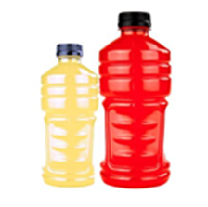
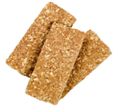

Impact on Your Athletic Performance
Phase 2: During Competition or Training:
DRINK:
-Hydrate with 10+ oz. of sports drink & water mix
EAT:
-Maintain blood sugar levels
FPO
10
Notes:
Staying hydrated is another essential part of “keeping the engine going”. A good way to get the electrolytes and decrease the sugar is to pour out half a sports drink and replenish it with water. Eating healthy snacks throughout the day keeps the blood sugars level. Think about what snacks are going to hold up well in a gym bag. Bananas are a great carb snack that doesn’t need to be refrigerated, but typically don’t hold up well in a gym bag.

Slide 11
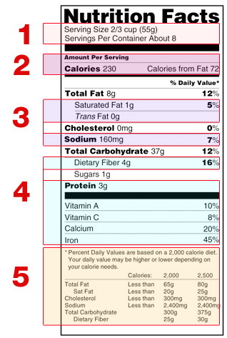
Reading Labels
Nutrition labels can be deceiving
1. Pay attention to the serving size
2. Limit the amount of total fat, sugar, and sodium.
3. Get enough of the suggested nutrients such as protein, fiber and vitamins.
4. Ingredients have hidden names for sugar most end in “cose”.
Example:
Sucralose
Glucose
Sucrose
Cane fructose
11
Notes:
Nutrition labels can be deceiving. Pay attention to the serving size. The number of servings in a food package is essential to note.
Get enough of the suggested nutrients, protein, fiber and vitamins.
Eating the suggested amount of total fat, sugar, cholesterol and sodium is important for a healthy diet
Be aware that ingredients often have hidden names for sugar. Hidden sugars tend to end in “cose.”

Slide 12
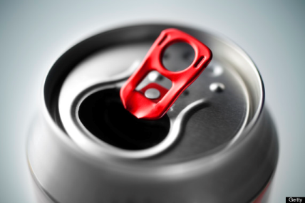
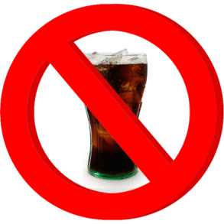
Student Leadership
Soda and sugary beverages have no nutritional value and are loaded with sugar.
These beverages are known to have many negative effects on the body, including heart diseases, diabetes, and weight gain.
Soda weakens enamel, which over time leads to bacterial plaque that causes cavities.
Even diet soda contains artificial sweeteners which can increase your cravings for sweets and junk foods.
FPO
12
Notes:
Soda is loaded with sugar in the form of high fructose corn syrup (HFCS). HFCS is known to have many adverse effects on the body, including elevated blood cholesterol and phosphorus levels, increased risk of heart diseases and diabetes, weight gain and morbid obesity, etc.
Each time soda is sipped, sugar bonds with bacteria in your mouth, giving rise to acid. This acid weakens enamel in teeth, which, over time, leads to bacterial plaque that causes cavities.

Slide 13
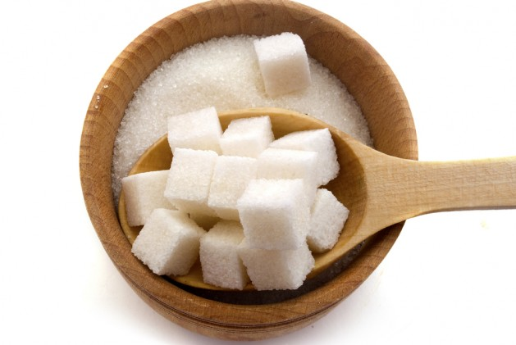
SUGAR
Natural Sugar
Fructose natural sugar found in:
fruits and honey
Glucose natural “simple” sugar in starches, such as:
potatoes and pasta
High Fructose Corn Syrup
HFCS is made from corn starch that is processed to glucose that turns into fructose
Links have been made with HFCS to obesity and heart disease
“Artificial Sweeteners”
Artificial sweeteners are synthetic sugar substitutes
Some sugar substitutes are natural and some are synthetic. Those that are not natural are called artificial sweeteners.
13
Notes:
It is important to pay attention to the types of sugars in the foods your athlete is eating. Natural sugars in moderation are fine, but significant amounts of artificial sweeteners are detrimental to performance.

Slide 14

Impact on Your Athletic Performance
Phase 3: Right after Competition or Training:
Single most critical factor in training effect taking place or not…
RECOVERY TIME
Hour 1 | 70%
Hours 2-8 | 20%
Hours 9-24 | 10%
Step 1 (Directly after):
-Drink 4-6 oz of Gatorade/Powerade & Water mix
Step 2 (10-30 minutes after):
-Drink 12-16 oz of Whey Protein or 20-30 oz of Low-Fat Chocolate Milk
-Eat 75g Carbohydrates(2 Handfuls of raisins or 2-3 fig bars)
Step 3 (1 hour):
-Eat full meal containing approximately: ½ fruits or vegetables ¼ protein ¼ carb
14
Notes:
These are some suggestions for after training. Liquid protein (such as low fat chocolate milk, whey protein or yogurt) is the quickest way to replenish the body and give muscles the proper nutrients to recovery for the next day. 70% of recovery happens in the first hour, making it critically important that the proper nutrition happens right away.

Slide 15
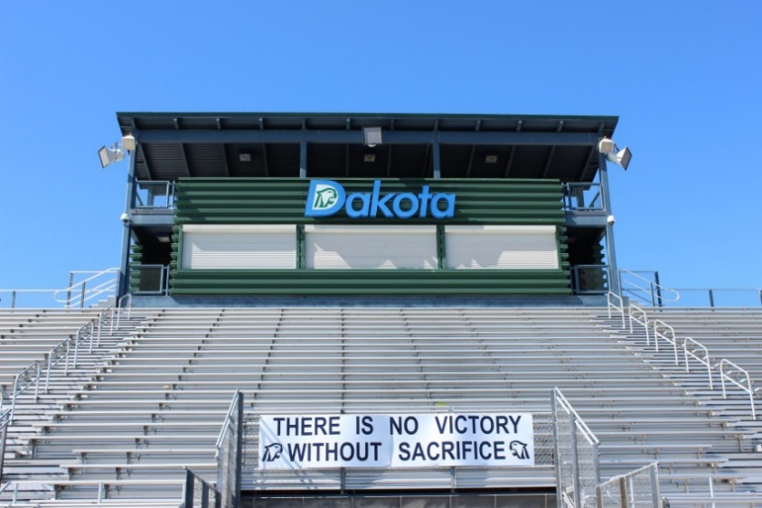
Impact on Your Athletic Performance
Alcohol, Marijuana, Tobacco, and Other Drugs
Interfere with your physical and mental ability.
  Strength/Speed is reduced
  Training-Recovery-Adaptation effect is impeded
  Lung Capacity is diminished
  Reaction time is slowed
  Neuromuscular connection is impacted
  Performance time is decreased
  Thought processes are reduced
FPO
15
Notes:
Let your athlete know that Alcohol, Tobacco, Marijuana and other Drugs have negative consequences for any athletic performance (and can lead to addiction).
A one night binge can effect the performance of an athlete for up to 14 days.
Tell your athlete that their brains are a “work in progress” and don’t stop developing until their mid-20s.
Tell them that teens become addicted to any substance (alcohol, marijuana, or tobacco, etc.) more quickly than adults because their brains are developing.
Tell them that the use of alcohol, marijuana, or other drugs can cause irreversible damage to the developing brain.

Slide 16
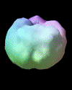
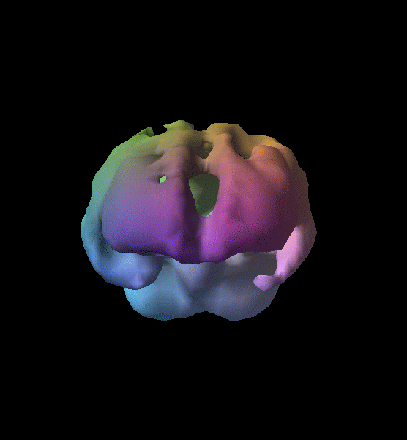
Brain Activity of a Teen Alcohol User
Healthy Teenager
Alcohol User
16
Notes:
These are brain scans of the healthy teenager and that of a teen that uses alcohol regularly. The areas missing in the scan on the right aren’t holes. They show areas of decreased blood flow and, therefore, decreased brain activity. This means the brain signals need to find another path within the brain to respond. The teen on the right is far less likely to perform well athletically and in school.

Slide 17

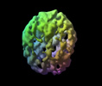

Brain Activity with Weekend Drug Use
Healthy Teenager
Weekend User
17
Notes:
These are scans of a healthy teenager’s brain and that of a teen that is a regular weekend alcohol user. Note the progression of brain change with use.

Slide 18
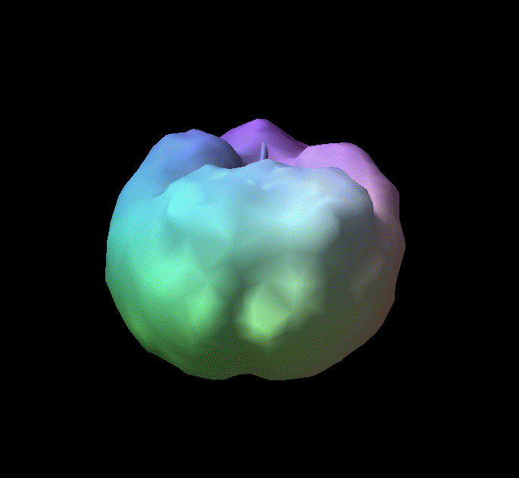
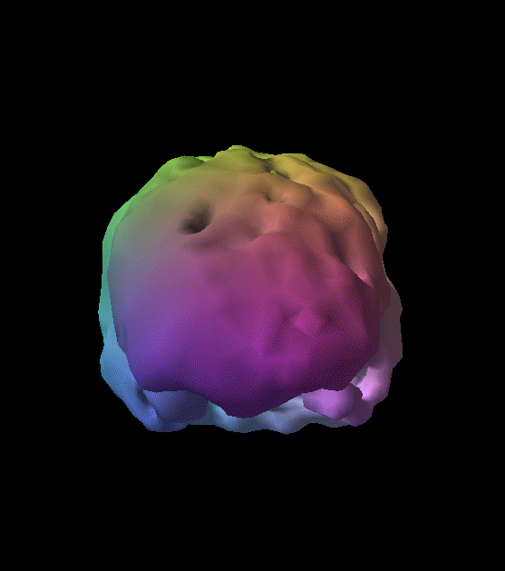

Brain Activity of a Teen Marijuana User
Healthy Teenager
Marijuana User
18
Notes:
These are scans of a healthy teenager’s brain and that of a marijuana user.
There is much less activity in the brain of the marijuana user. This means that the ability to think, react, store memory, and learn is negatively affected.
Use of marijuana can significantly affects performance many days after use.

Slide 19
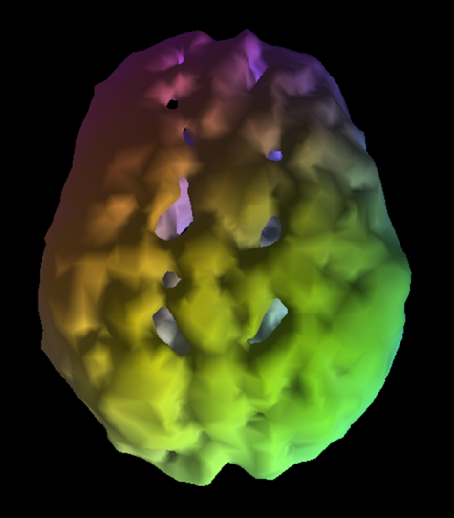
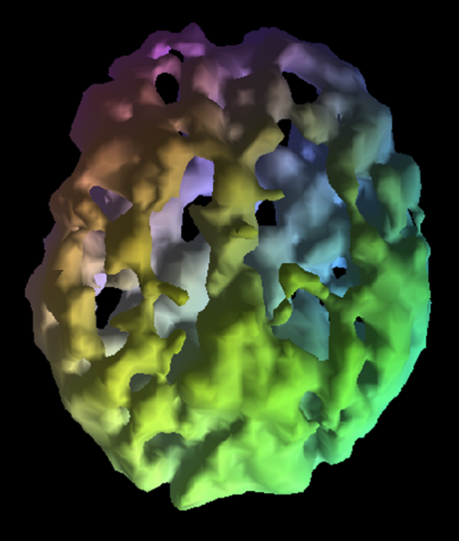
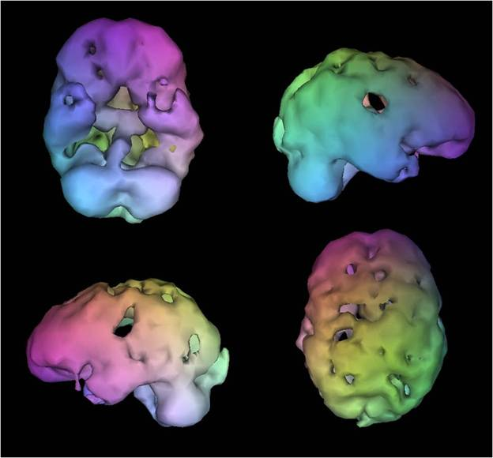
Brain Activity – The Results of Using Other Drugs
Cocaine User
Meth User
Heroin User
19
Notes:
Use of these substances dramatically affects brain chemistry and has negative affects on all areas of development.

Slide 20

Impact on Athletic Performance
Alcohol - Lost Performance & Injury Rate
High School Athletes lose between 15% to 30% from their overall performance when they drink alcohol.
ONE NIGHT of binge drinking ELMINATES the impact of TWO WEEKS of training.
Athletes who drink regularly are TWO TIMES as likely to be injured as non-drinkers
  54% Injury Rate for drinkers.
  24% Injury Rate for non-drinks.
20
Notes:
Athletes that drink alcohol are not only at risk for injury. One night of drinking can negatively effect 2 weeks of overall play.

Slide 21
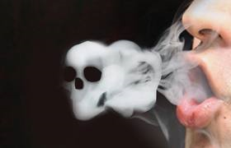
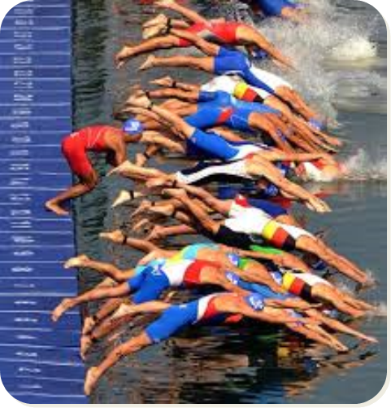
Impact on Your Athletic Performance
Marijuana
Contains 4x the amount of tar found in Tobacco smoke
Contains 50-70% More Carcinogens
FPO
Response time to visual stimulus
Condition | Msec/response
Well Rested | .186
Without Sleep | .246
Marijuana User | .300-.450
21
Notes:
Marijuana contains 4x the amount of tar found in Tobacco smoke and 50-70% more Carcinogens (chemicals that cause cancer).
Considerable research shows that Marijuana affects coordination, reaction time, attention, memory, and is addictive, especially for teens. (ncadd.org 2015)
It’s important that we work to promote healthy choices by our athletes.

Slide 22
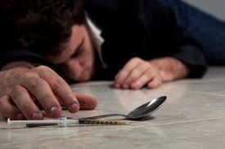
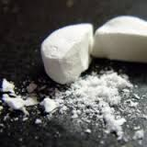

Impact on Your Athletic Performance
Use of Prescription Pain Killers (Opioids)
Vicodin, Percocet, Oxycontin, etc.
ONLY to be used as instructed by a professional
  As injury becomes better, the addiction becomes worse
  Properly secure and dispose of all medication
Signs of an addiction:
  Physical and Emotional Changes:
  Clammy skin, tiny pupils, skin rashes, nausea and vomiting, difficulty breathing,, sleepiness, confusion, low energy levels, seizures, low blood pressure, coma
  Depression, aggravation, violence, change of personality
Prescription Drug Abuse can easily lead to heroin use/addiction.
FPO
22
“Sports Injury Leading to Oxycodone Addiction”. Oxycodone Addiction Help. October 30, 2014. http://www.oxycodoneaddictionhelp.com/sports-injury-leading-to-oxycodone-addiction
Notes:
Athletes are at higher risk of developing an addiction to pain medication, e.g. Vicodin, Percocet, Oxycontin, etc.
We need to be very aware of the dangerous potential for pain medication prescribed for an injury to end in addiction.
Parents need to monitor when their athletes take prescriptions for treating the pain and prompt them stop use as soon as soon as possible.
Abuse of Prescription Painkillers can lead to Heroin use/addiction.
You can dispose of unused and expired medication at the Macomb County Sheriff’s Dept. and the Clinton Township Police 24 hours per day, 7 days per week.

Slide 23
The Role of Parents
SUPPORT YOUR ATHLETE!
Parenting Do’s:
  Cheer everybody on the team,
  not just your child
  Model appropriate behavior
  Know what is suitable to discuss with the coach
  Encourage your child to talk to the coach first
  Be a good listener and great encourager
  TALK WITH YOUR ATHLETE ABOUT THE DANGERS OF ALCOHOL, MARIJUANA, AND OTHER DRUGS AND OF PRESCRIPTION DRUG ABUSE.
Parenting Don’ts:
  Overemphasizes sports at the expense of sportsmanship
  Have different goals than your child
  Treat your child differently after a loss
  Undermine the coach
  Live your dream through your child
FPO
Henson, Steve. “What Makes A Nightmare Sports Parent- And What Makes A Good One.” The Post Game. 2.15.12. http://www.thepostgame.com/blog/more-family-fun/201202/what-makes-nightmare-sports-parent. 9.24.14.
23
Notes:
We look forward to the season/year and working together to support your students. We wanted to outline the behaviors we know everyone in this room is ready and willing to follow to ensure a great season/year.

Slide 24

Chippewa Valley Schools
ATHLETIC CODE OF CONDUCT
We Support Good Sportsmanship and Educational Athletics
Our Athletic Community is EXPECTED
to be RESPECTFUL and RESPONSIBLE!
  Cheer positively for your own team – follow the lead of cheerleaders
  No taunting, No disruptive behavior, No distractive cheers
  Accept officials’ decisions
Join our SPORTMANSHIP TEAM:
Teach Good Sportsmanship
Encourage Good Sportsmanship
Advocate Good Sportsmanship
Model Good Sportsmanship
24
Notes:
A student, by participating on a school team, is voluntarily submitting to abide by the rules, requirements, standards, and regulations in the Athletic Code of Conduct, as well as any rules, requirements, standards, and regulations of the team. Being on a team is a privilege, not a right. Therefore, it is crucial for student athletes to understand the Athletic Department’s expectations of them, and what they may expect from the athletic program.
The Athletic Code of Conduct provides the Athletic Mission Statement for Chippewa Valley Schools, as well as Athletic Program Beliefs, Eligibility, Rules, Transportation Policy, Attendance Requirements and Vacation Policy, Academic Standards for Athletes, Conduct Expectations for Athletes, Consequences and Appeal Procedures. All athletes and their parents are expected to read and to be familiar with this document. Any questions should be directed to the coach or Athletic Director.

Slide 25

Chippewa Valley Schools
ATHLETIC CODE OF CONDUCT
ADDICTIVE AND ILLEGAL SUBSTANCES
AND OTHER MISCONDUCT
Addictive substances – the use, possession, distribution or sale of addictive and illegal substances by student athletes is prohibited.
Other Misconduct: Any conduct that dishonors the athlete, the team and the school will not be tolerated. For any acts of unacceptable conduct such as , but not limited to, theft, extortion, vandalism, assault, sexual misconduct, gross disrespect, hazing, or inappropriate use of the internet, electronic devices or communication systems.
FPO
25
Notes:
An important part of the Chippewa Valley Schools Athletic Code of Conduct is that which addresses the use, possession, and/or distribution of alcohol, marijuana, or other drugs, as well as the abuse of prescription medications and/or sharing of medications prescribed to someone else.

Slide 26
ATHLETIC CODE OF CONDUCT
Consequences of Use of Addictive and
Illegal Substances:
First Offense – 25% of competitions, plus taking the online Life of an Athlete course. Certification on completion is required.
Second Offense – 50% of competitions, plus professional consultation selected by the school district and paid for by the athlete. Verification from the professional agency is required following completion of the consultation.
Third Offense – Suspension from all competitions for the remainder of middle school or high school career.
*An athlete’s first tobacco violation – 10% of competitions. For any further tobacco violation, the above consequences will apply.
26
Notes:
Read through the Consequences.

Slide 27
Important Information
Dan Serard
Program Coordinator, Life of an Athlete
VISIT
Chippewa Valley Schools Life of an Athlete Website
Leadership Guide
Powerback Diet
The Coaches’ Playbook
Sleep and Recovery
Code of Conduct
And More!
Questions? Contact Your Coach or Athletic Director
Notes:
Visit our Athletic webpage to get important additional information that is highly relevant to athletic performance.

