Slide 1

House Bill 4822
Michigan’s Reading Retention Law
2017-2018

Slide 2
Michigan’s Reading Retention Law
Signed by Governor Snyder on October 6, 2016
The actual “Retention” part of this law does not take effect until the spring of 2020
Basic premise is that all students are expected to be reading at grade level by the end of third grade
If not, they are to be retained in 3rd grade (unless there are special circumstances)

Slide 3


Michigan’s Reading Retention Law
All districts are required to use an evidence-based core reading program that is comprehensive.
The program must include the 5 Big Components of Reading:
  Phonemic Awareness
  Phonics
  Fluency
  Vocabulary
  Comprehension

Slide 4

Michigan’s Reading Retention Law
All districts are required to use an approved benchmark screener (NWEA) to assess all students in K-3 in the first 30 days of school and then again in the winter and spring.
Notes:
CVS implemented NWEA/MAP as a district benchmark assessment in 2013 and all students already complete this assessment within the first 30 days – However this year when results are sent home, students who are not at the 50th percentile or above will receive a slightly different letter that briefly explains the law and invites the parents to a meeting that will take place during conferences

Slide 5
Michigan’s Reading Retention Law
Any student K-3 identified with a reading deficiency must be given an Individual Reading Intervention Plan (IRIP) developed by his/her teacher, parent, interventionist, and administrator.
If a student’s NWEA reading score is below the 50th percentile, parents will receive and IRIP at parent teacher conferences in October.
Notes:
If your child’s NWEA reading score places them below the 50th percentile nationally, you will receive an IRIP at parent teacher conferences in October. This plan will explain your child’s current scores, how his/ her teacher will ensure they learn grade level content through the Journeys program, what interventions your child will receive in school to provide additional support and ideas for parents to work on at home.

Slide 6
Michigan’s Reading Retention Law
Requirements of Law | Chippewa Valley Schools
1. Core reading instruction | Journeys
2. Benchmark reading assessment | NWEA
3. Individual Reading Plan | IRIP developed and given at conferences, interventions will be identified for the year
4. Provide interventions | iREAD & others
5. Progress monitoring of students | Dibels/DRA
Notes:
Pass out MISD handout --

Slide 7
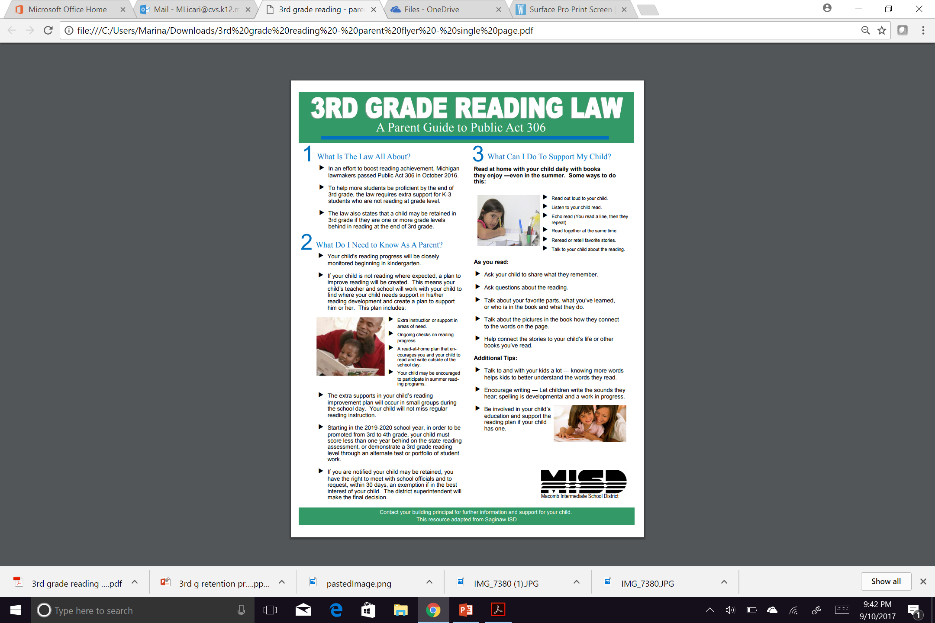
Additional Information

