Slide 1
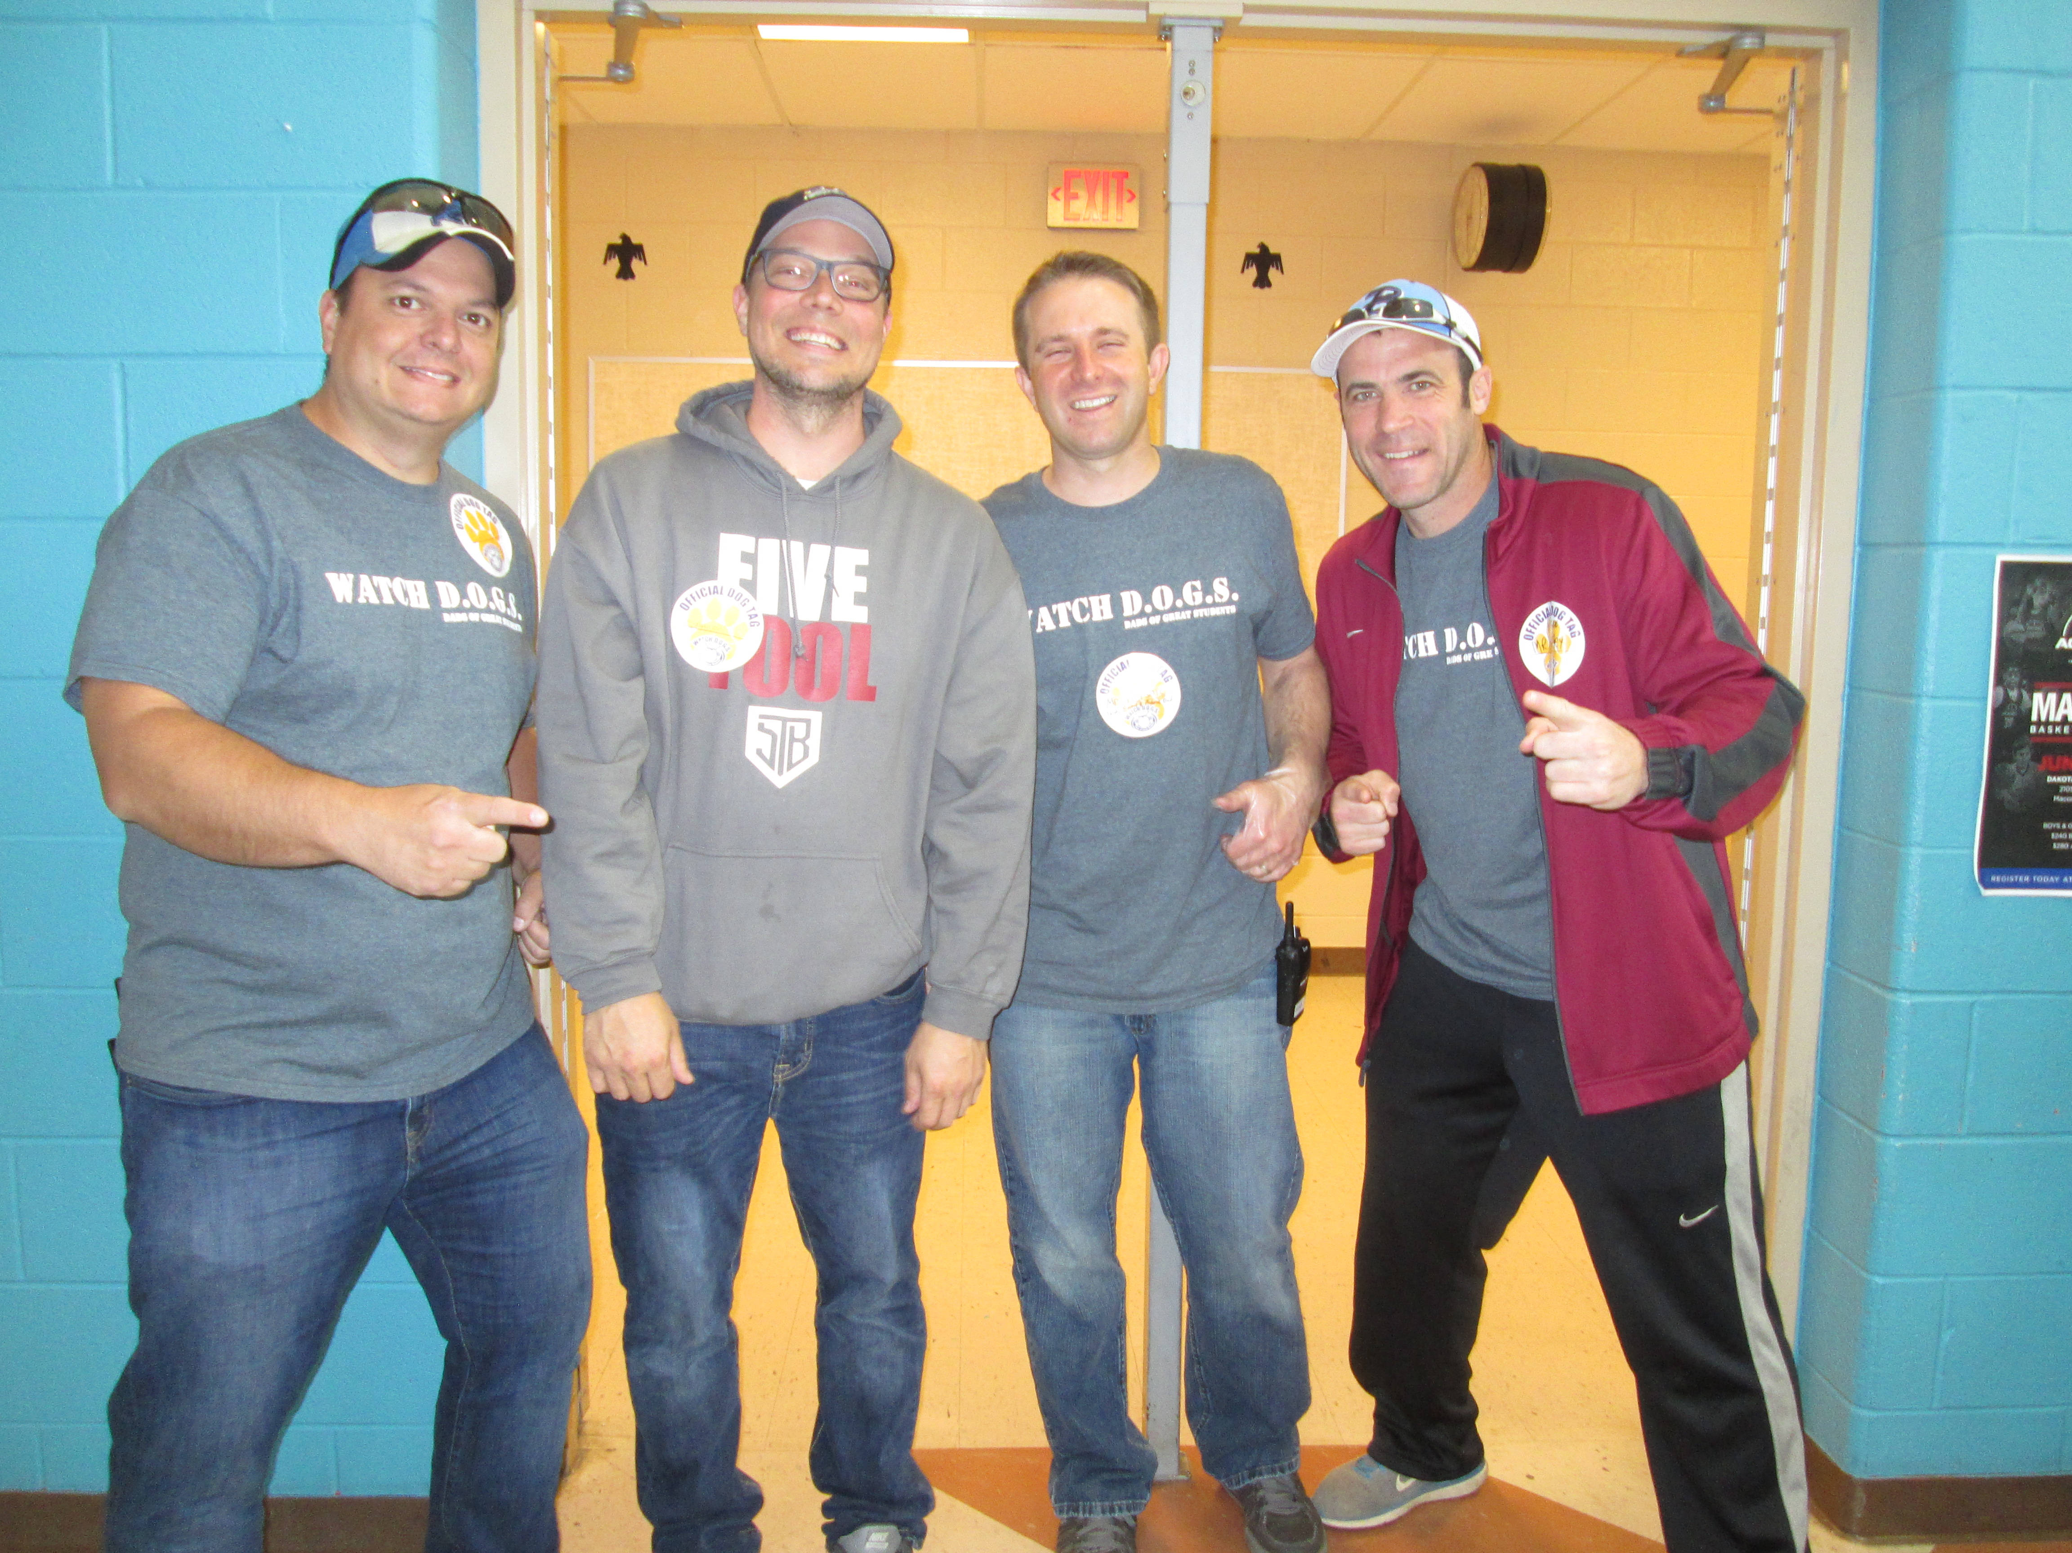
What is watch d.o.g.s.?
Your Impact Counts
For our school Watch d.o.g.s. are fathers and/or male guardians who volunteer for at least one day each year at Sequoyah helping during all lunches and recess.

Slide 2
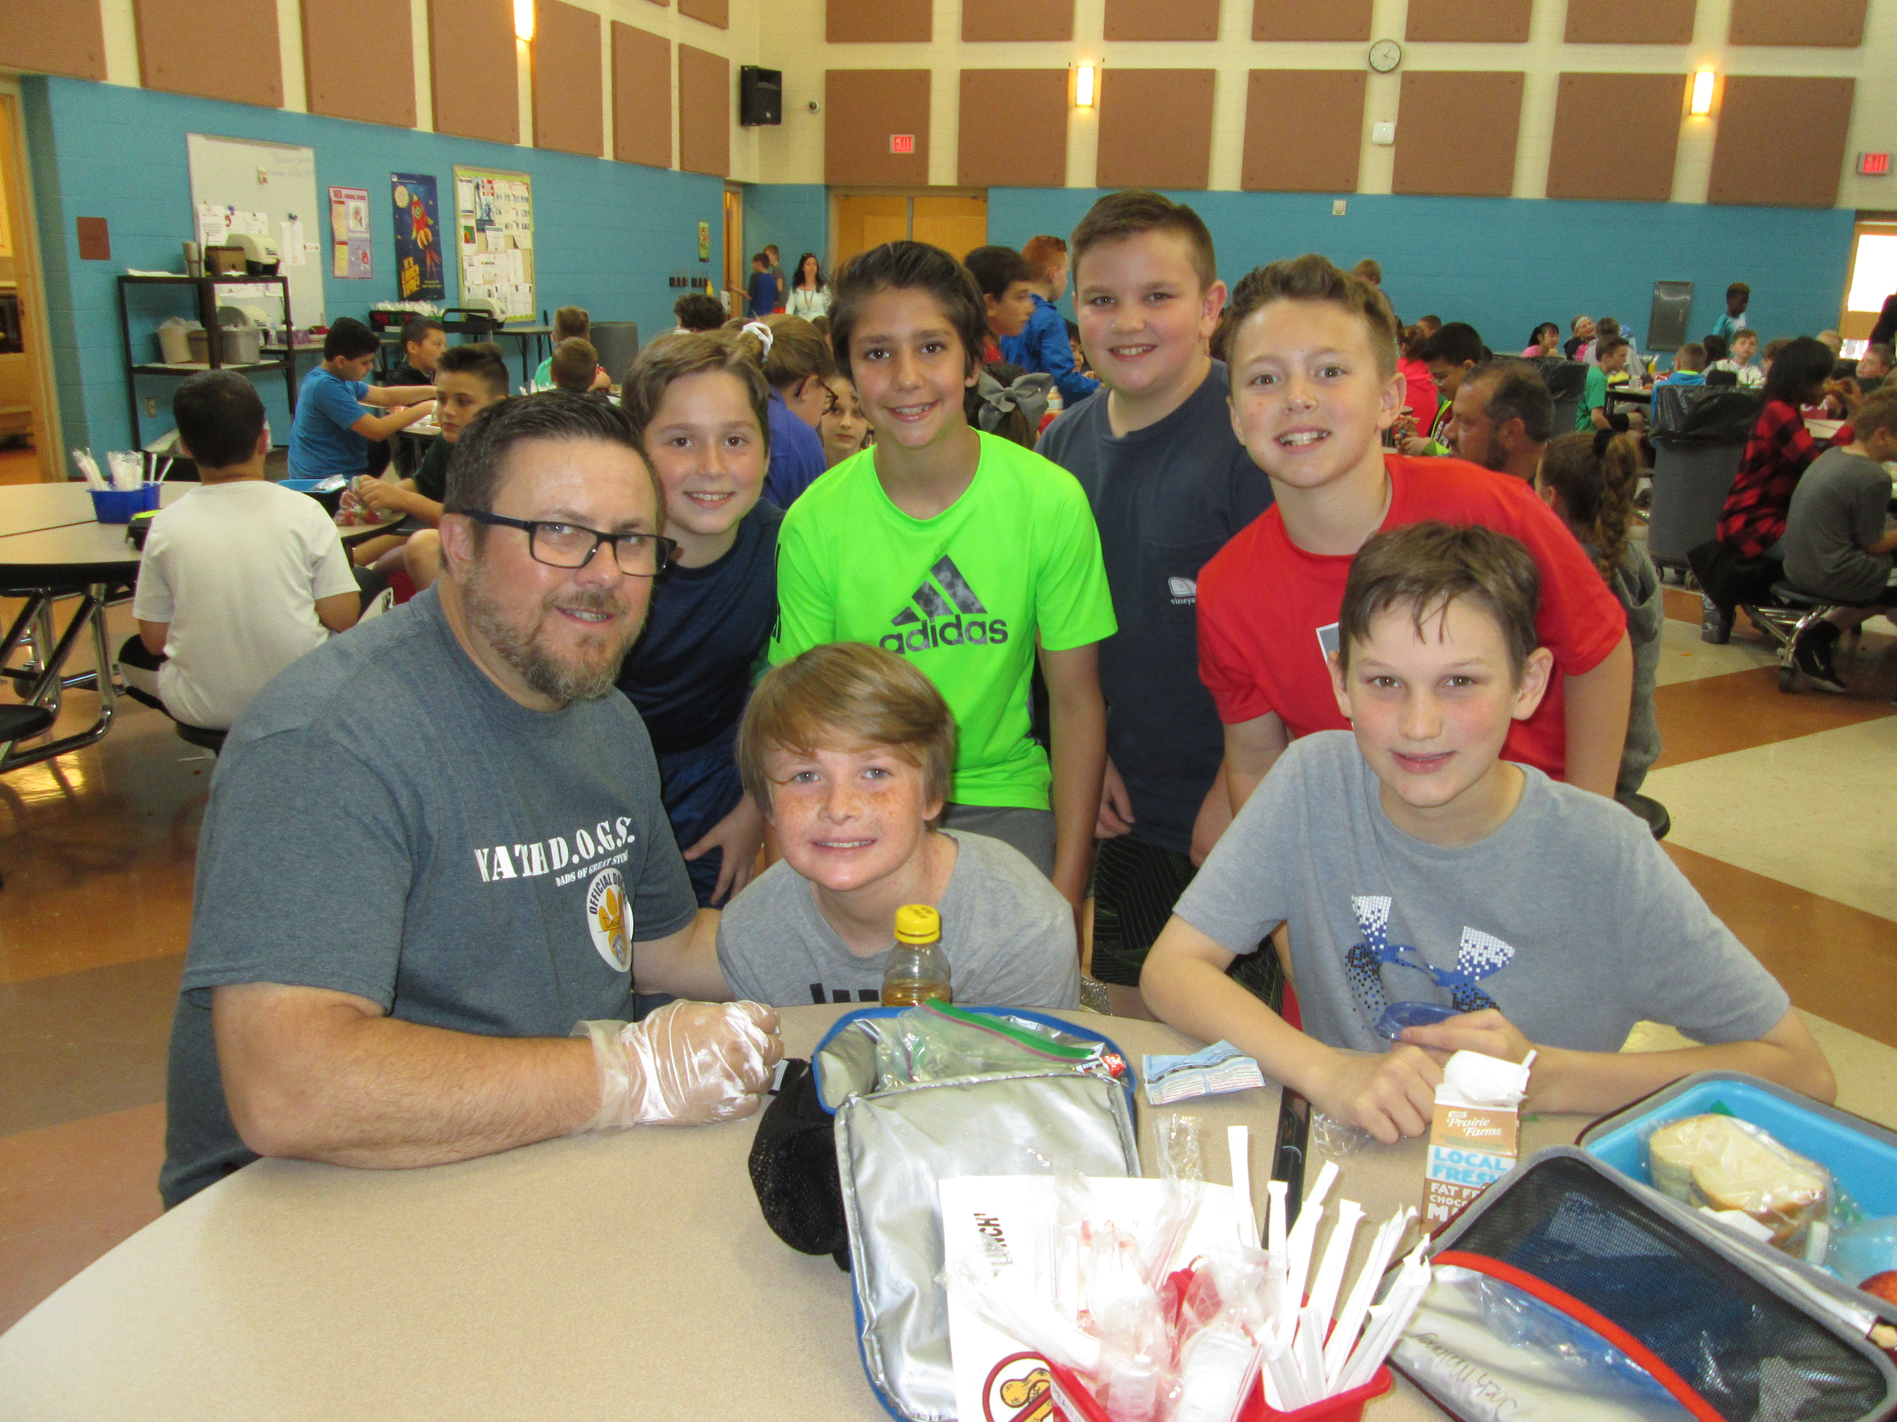
Watch d.o.g.s. coordinators please put this information into your phone
Mrs. Dagati
5th grade teacher
Email: adagati@cvs.k12.mi.us
Phone: 586.723.7102
Mr. Patton
5th grade teacher
Email: wpatton@cvs.k12.mi.us
Phone: 586.723.7103

Slide 3
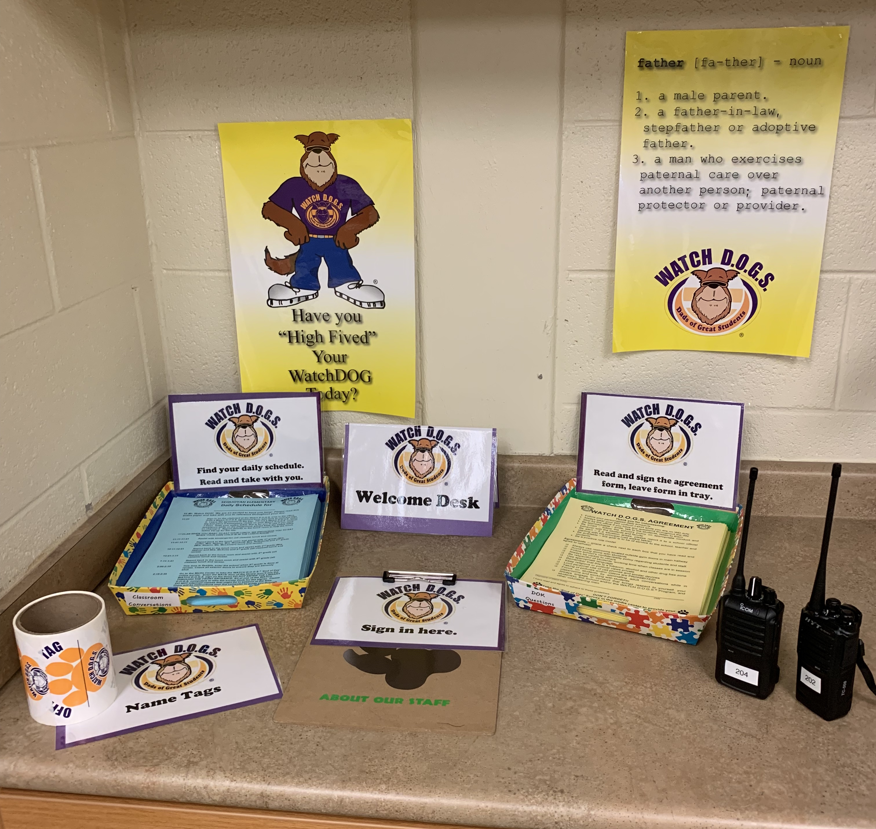
Daily routine
Report directly to the office and tell the ladies in the office you are a watch dog. The ladies will direct your attention to the area where you will Sign your agreement form (yellow paper), grab your daily schedule (blue paper), put on a name tag and grab your walkie talkie. you will be here from 11:00-2:30

Slide 4
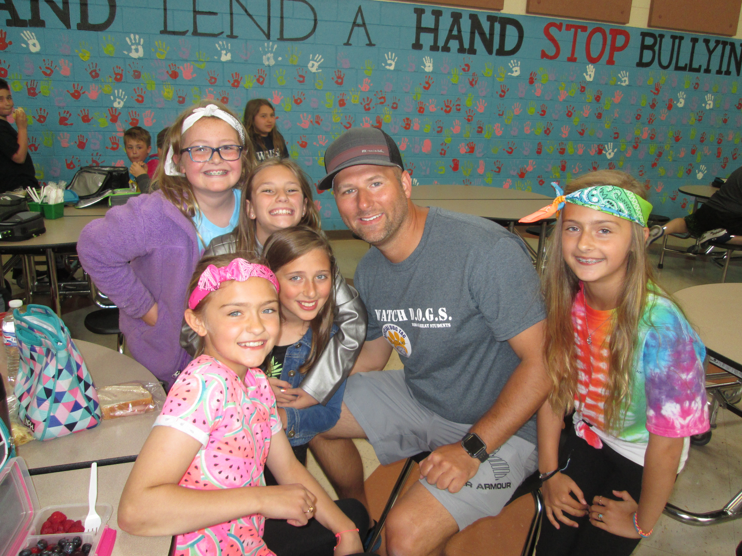
Daily routine
Don’t forget to bring a lunch and dress appropriately
Report to the lunchroom and help lunch ladies set up
Follow kids Outside for outdoor recess and engage yourself with the kids. IE: walk around, help coordinate a game, etc. you will come back in when the ladies from the lunch room come back in.
If it is indoor recess, stay with kids, circulate the lunch room, engage!
wear your Watch Dog uniform t-shirt while you are on Watch dog duty

Slide 5
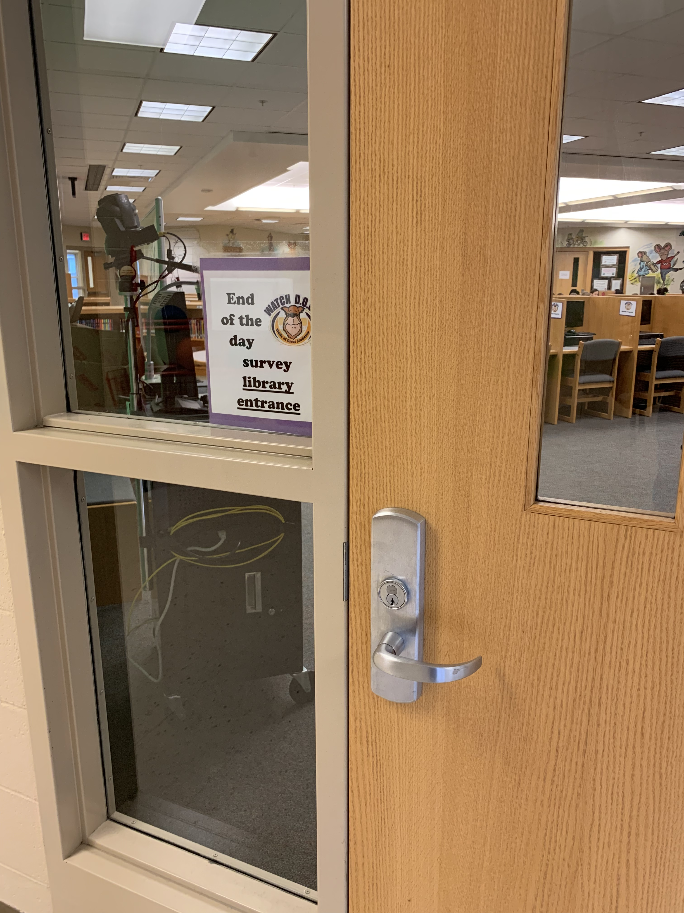
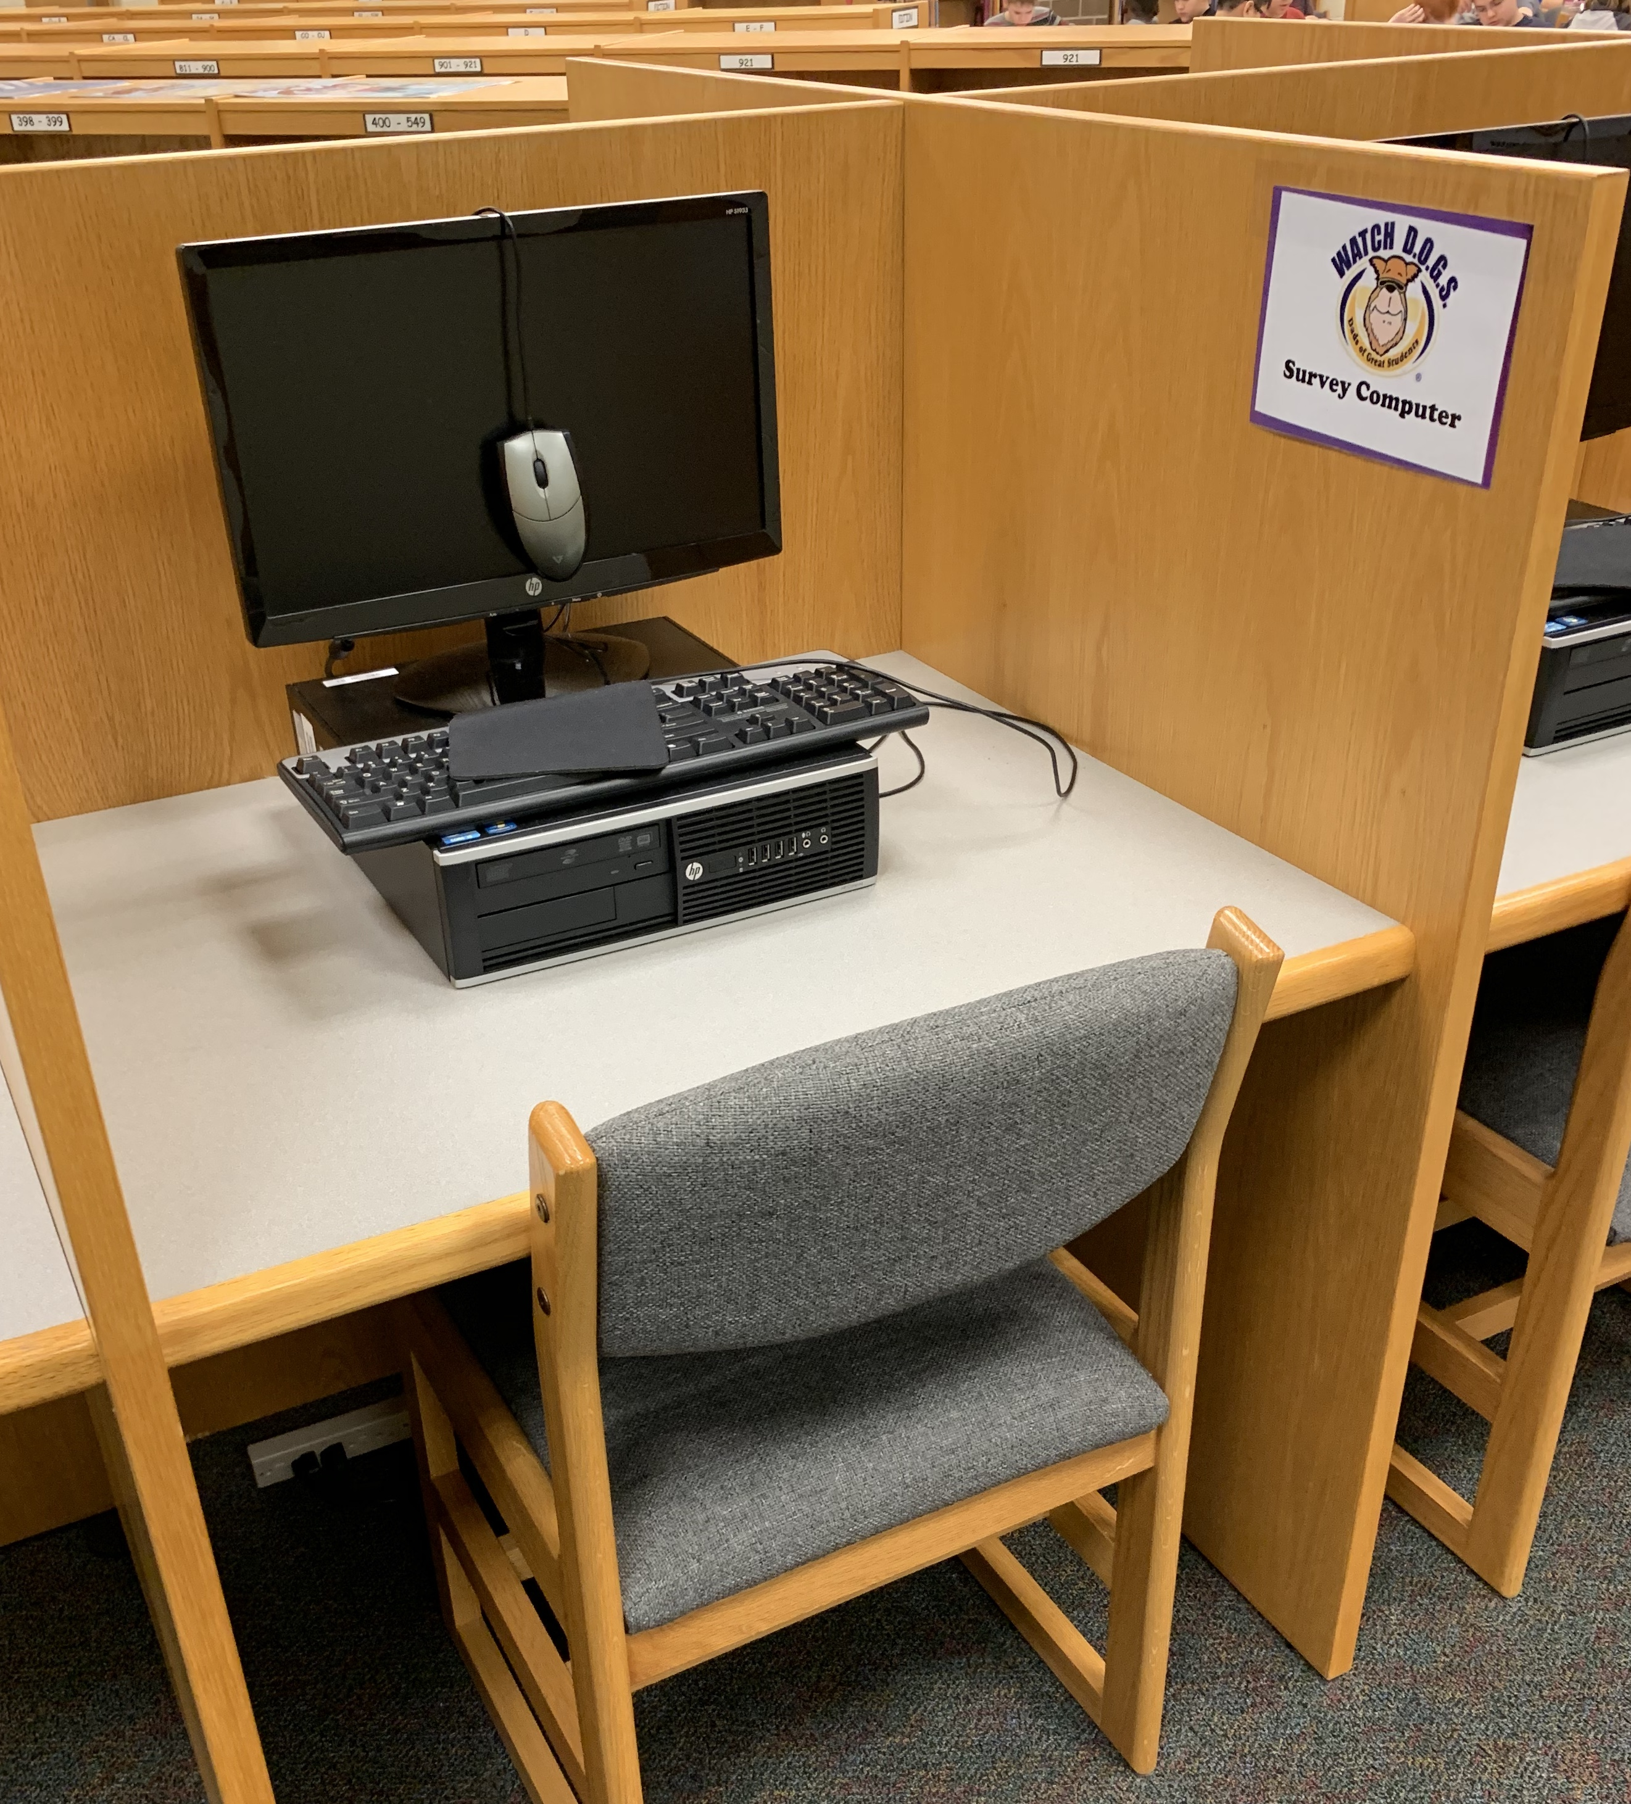
End of the day survey look for the watch D.O.G.S. signs
At the end of your day, check all exterior doors and Report to the library to take the ‘End of Day’ Survey to provide your feedback.

Slide 6
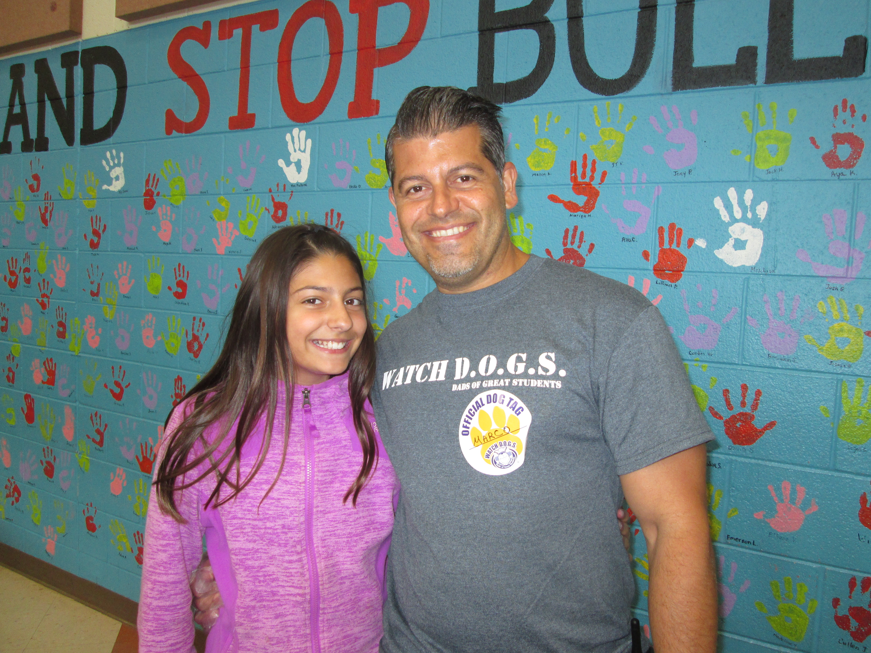
Want to extend your time?
Many dads want to spend their time in the classroom as well. If you sign up for a Watch DOGS day and you have the ability to come early or stay later, feel free to email your child’s teacher. You can let them know you are available to help in their classroom on that same day! Either BEFORE or AFTER your Watch DOGS duty time (11:00-2:00). We cannot guarantee that the teacher may need you on that particular day but if your time allows it’s worth an email.
*** Please DO NOT just show up to the teacher’s classroom and ask to help. Teachers schedule classroom volunteers so, this should be something that you organize ahead of your day.

Slide 7
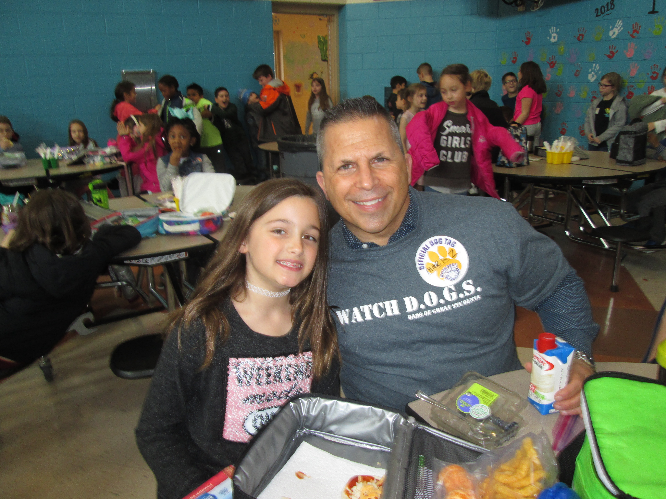
Be the best watch d.o.g.
BE APPROACHABLE – SMILE, TALK TO THE STUDENTS, LISTEN TO THEM
BE SMART – FOLLOW THE SCHOOL’S POLICY ON APPROPRIATE CONDUCT AND BEHAVIOR WITH THE STUDENTS AND FACULTY
BE ALERT – IF A SITUATION ARISES, PLEASE REPORT IT TO A SCHOOL OFFICIAL STARTING WITH THE PRINCIPAL (UTILIZE WALKIE TALKIE)
BE AVAILABLE – THE GOAL IS TO BE OF SERVICE TO THE SCHOOL, TEACHER AND STUDENTS
BE A POSITIVE ROLE MODEL, be you!

Slide 8
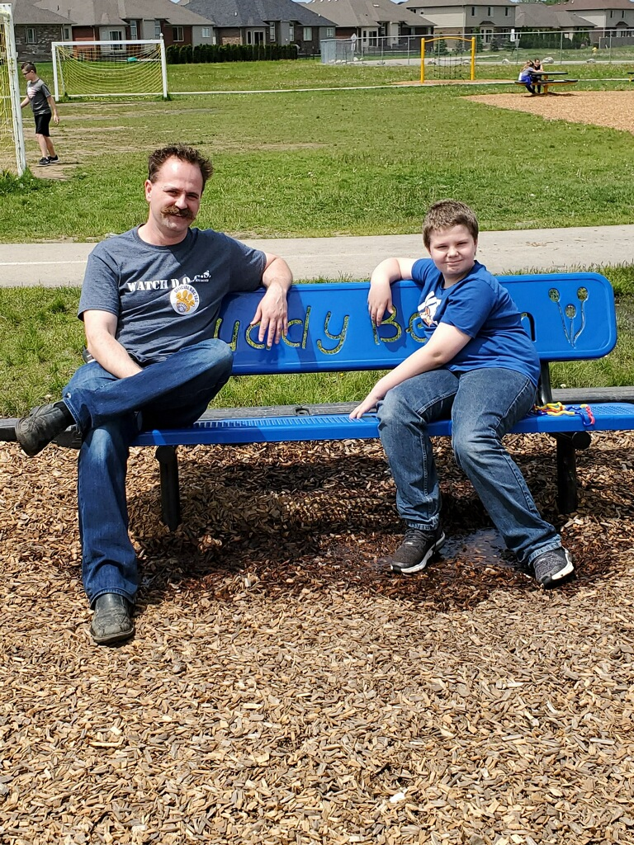
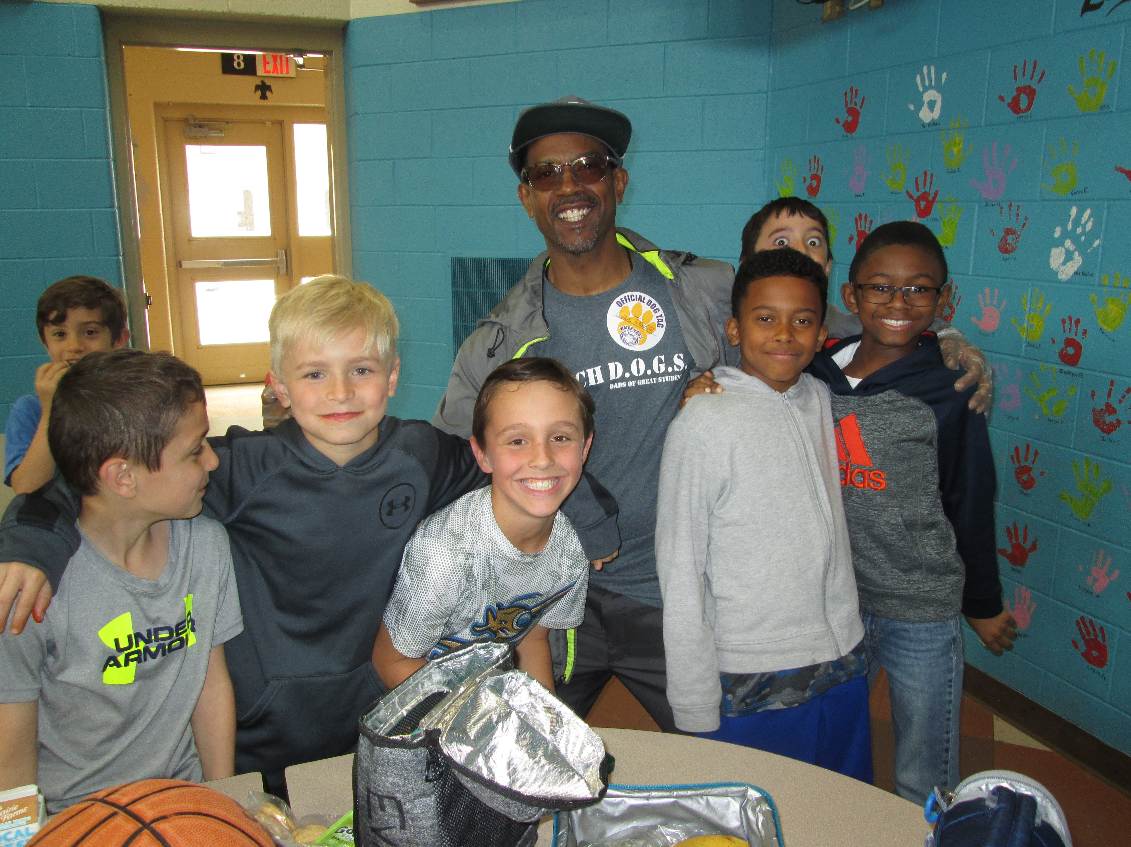
Engage with the kids!

Slide 9
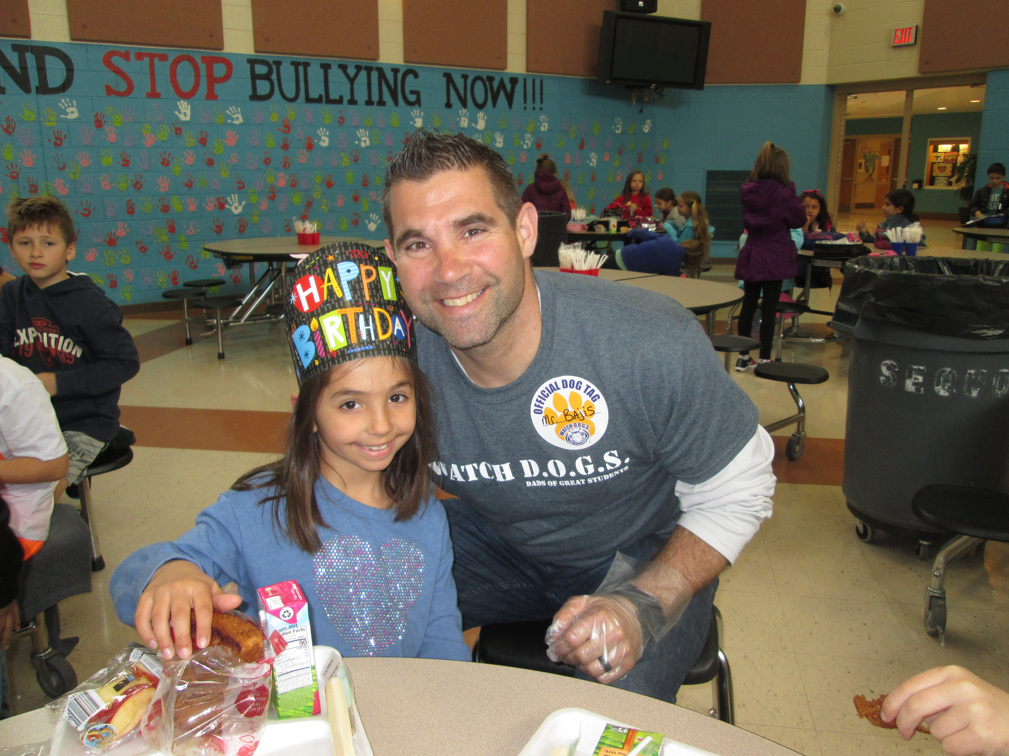
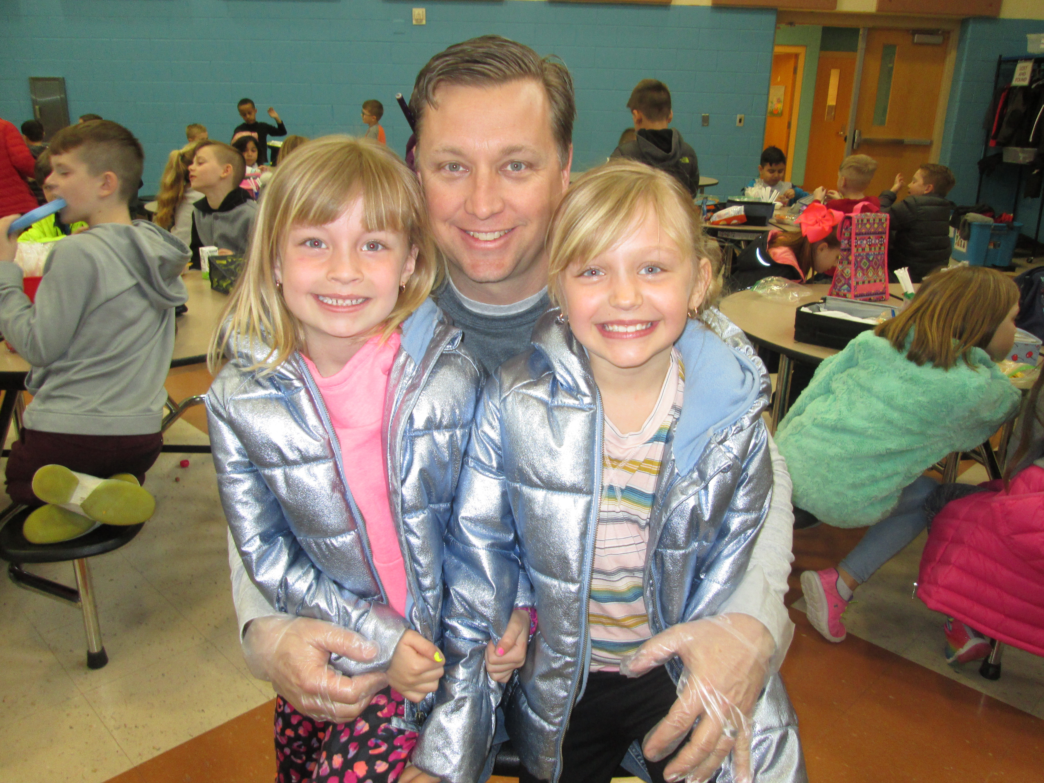
Make your child’s special day even more fun! Celebrate Birthdays, special student days, etc…

Slide 10
Sign up now to be a watch d.o.g.
Go to the Sequoyah website and look for…
Parents/students tab
Then click on watch d.o.g.s.
Find the sign up genius link

Slide 11
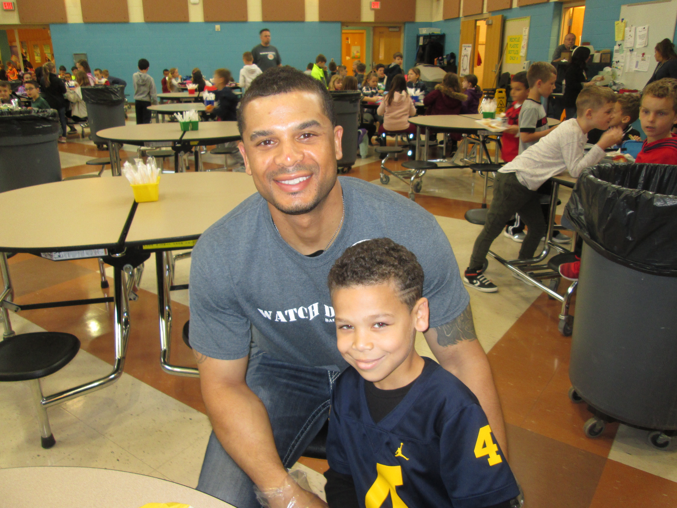
NEW D.O.G.S. PLEASE EMAIL US
First and last name
Phone number
Email address
children's names,
grade level and teacher
Shirt size (free to you ☺
thanks to the Generosity of pto)

Slide 12
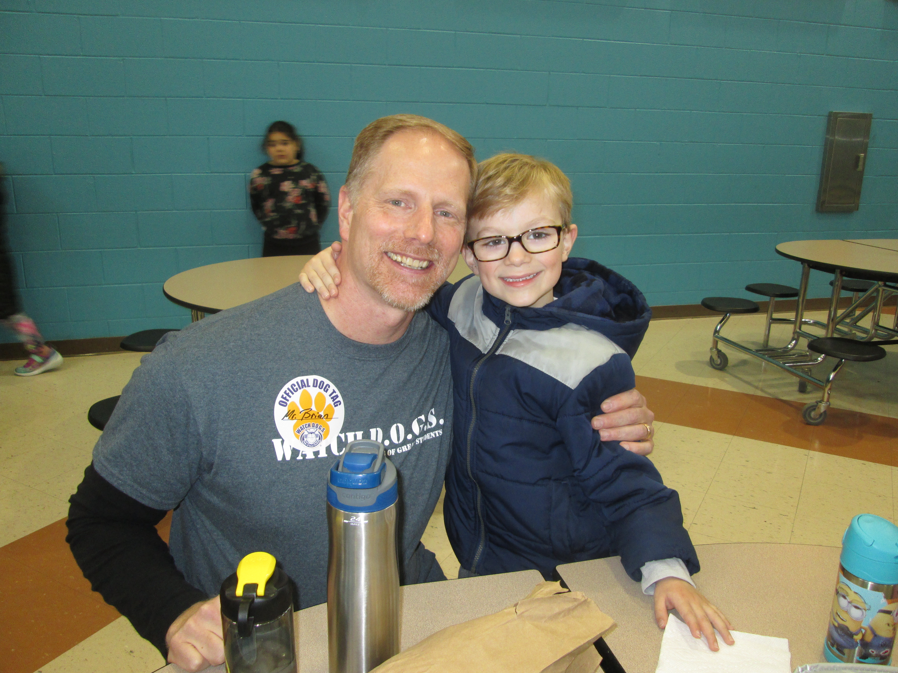
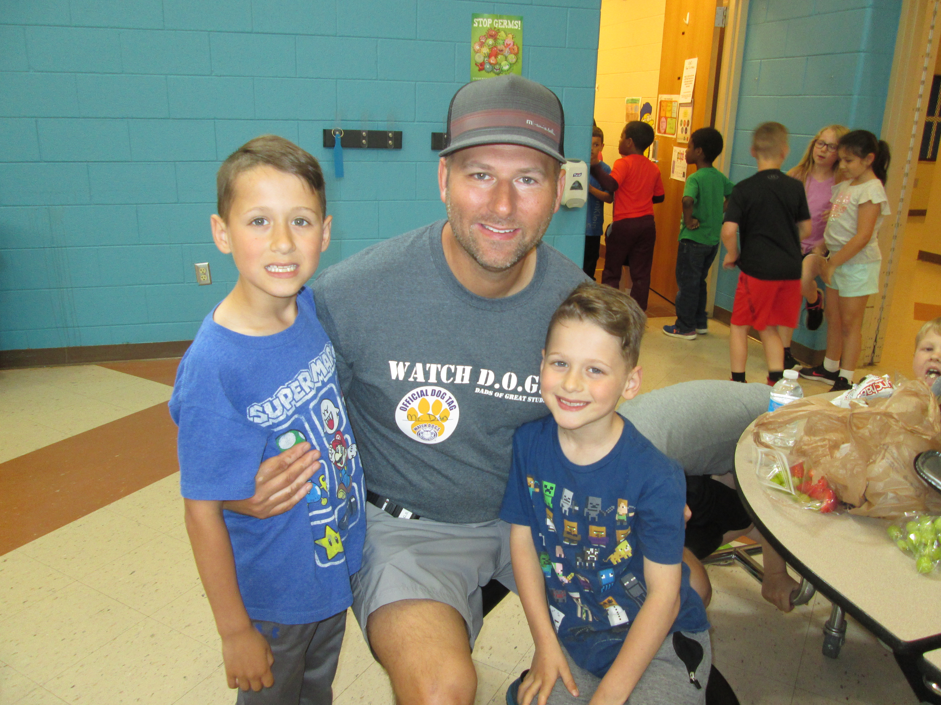
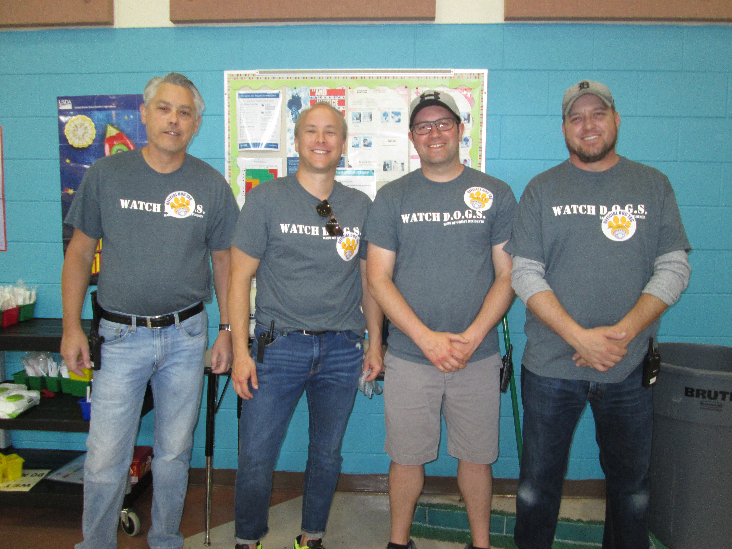
Thank you for being part of our WAtch d.o.g.s.
This Photo by Unknown author is licensed under CC BY-SA.

